Slide 1
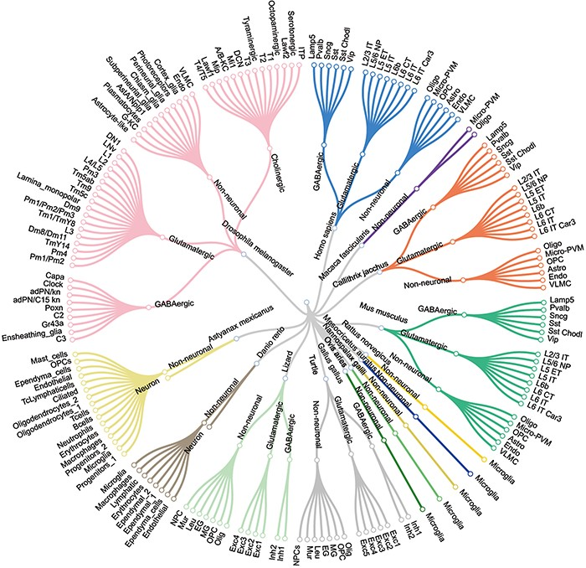
Figure 2. The major cell types and sub-cell types identified for each species.
Notes:
Figure 2. The major cell types and sub-cell types identified for each species.
Unless provided in the caption above, the following copyright applies to the content of this slide: © The Author(s) 2023. Published by Oxford University Press.This is an Open Access article distributed under the terms of the Creative Commons Attribution License (https://creativecommons.org/licenses/by/4.0/), which permits unrestricted reuse, distribution, and reproduction in any medium, provided the original work is properly cited.

Slide 2
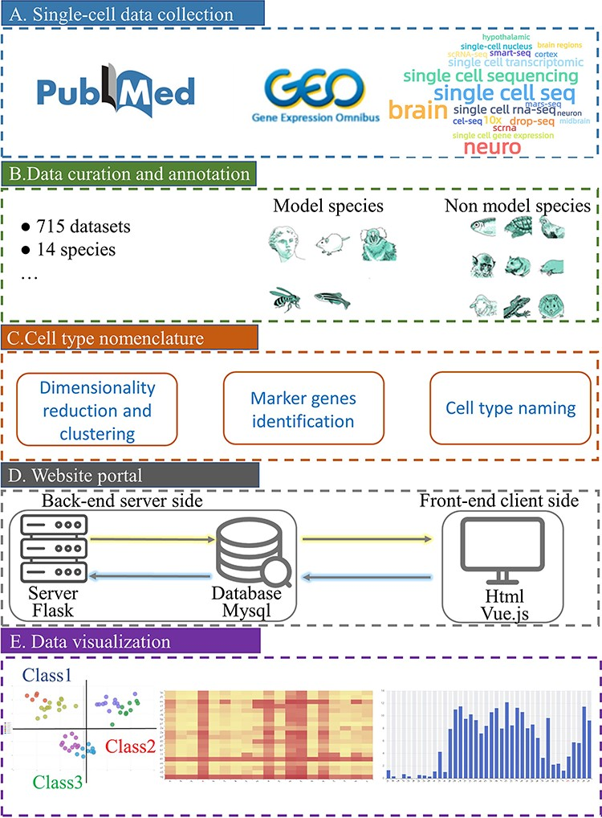
Figure 1. Schematic overview of scBrainMap database construction. (A) Literature search in PubMed and GEO with a list ...
Notes:
Figure 1. Schematic overview of scBrainMap database construction. (A) Literature search in PubMed and GEO with a list of well-defined keywords. (B) All datasets were manually curated for various species. (C) Cell-type clustering and naming were performed. (D) The database portal was built for both the front end and the back-end. (E) Convenient visual and interactive user interfaces were implemented.
Unless provided in the caption above, the following copyright applies to the content of this slide: © The Author(s) 2023. Published by Oxford University Press.This is an Open Access article distributed under the terms of the Creative Commons Attribution License (https://creativecommons.org/licenses/by/4.0/), which permits unrestricted reuse, distribution, and reproduction in any medium, provided the original work is properly cited.

Slide 3
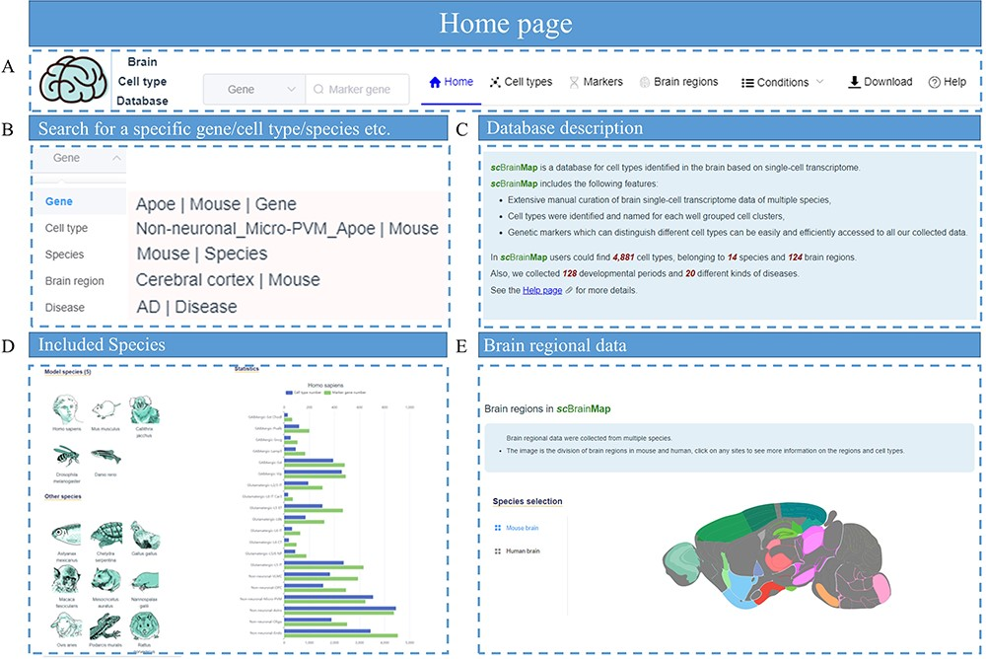
Figure 3. Screenshot of scBrainMap database homepage. (A) The navigation bar. (B) Live search box. (C) Database ...
Notes:
Figure 3. Screenshot of scBrainMap database homepage. (A) The navigation bar. (B) Live search box. (C) Database introduction. (D) Statistical plot for each species and (E) brain regions.
Unless provided in the caption above, the following copyright applies to the content of this slide: © The Author(s) 2023. Published by Oxford University Press.This is an Open Access article distributed under the terms of the Creative Commons Attribution License (https://creativecommons.org/licenses/by/4.0/), which permits unrestricted reuse, distribution, and reproduction in any medium, provided the original work is properly cited.

Slide 4
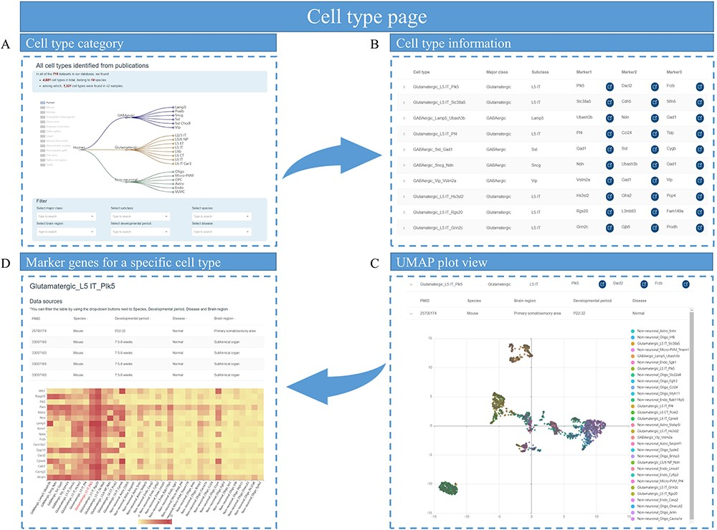
Figure 4. Cell types page of scBrainMap. (A) At the top of the page is a tree of major class and subclass cell types ...
Notes:
Figure 4. Cell types page of scBrainMap. (A) At the top of the page is a tree of major class and subclass cell types for each species. (B) The cell-type information table contains the name of the cell type, major class, cell subclass and their top marker genes. (C) An UMPA plot of single-cell clustering is displayed. (D) Heatmaps of DEG in cell types are visualized.
Unless provided in the caption above, the following copyright applies to the content of this slide: © The Author(s) 2023. Published by Oxford University Press.This is an Open Access article distributed under the terms of the Creative Commons Attribution License (https://creativecommons.org/licenses/by/4.0/), which permits unrestricted reuse, distribution, and reproduction in any medium, provided the original work is properly cited.

Slide 5
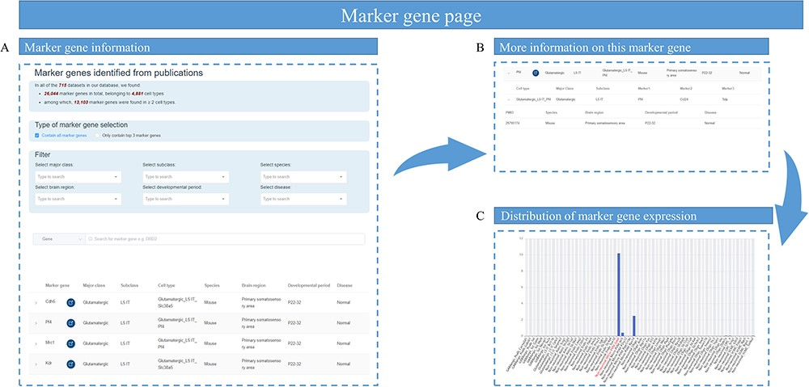
Figure 5. Overview of marker gene page. (A) The marker gene information table containing marker gene name, the link to ...
Notes:
Figure 5. Overview of marker gene page. (A) The marker gene information table containing marker gene name, the link to National Center for Biotechnology Information website and the cell types that contain this marker gene. (B) Sample information of this marker gene, such as the species, brain region, developmental stage and disease status. (C) A bar graph showing the expression of a marker gene among different cell types.
Unless provided in the caption above, the following copyright applies to the content of this slide: © The Author(s) 2023. Published by Oxford University Press.This is an Open Access article distributed under the terms of the Creative Commons Attribution License (https://creativecommons.org/licenses/by/4.0/), which permits unrestricted reuse, distribution, and reproduction in any medium, provided the original work is properly cited.

Slide 6
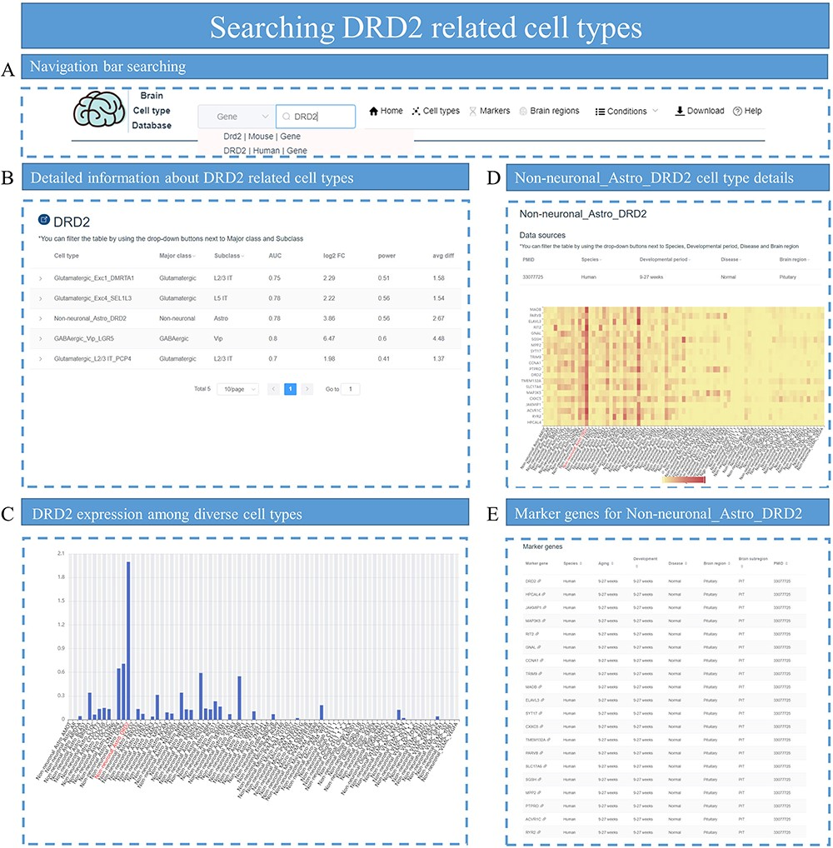
Figure 6. Identifying DRD2-related cell types. (A) Search for DRD2 in the search box of the homepage. (B) All cell ...
Notes:
Figure 6. Identifying DRD2-related cell types. (A) Search for DRD2 in the search box of the homepage. (B) All cell types related to DRD2 are displayed, with parameters associated with DEGs such as log2 FC and power value. (C) Bar plot shows the distribution of DRD2 expression among cell types in that specific dataset. (D) The heatmap plot for top DEG expression distribution is displayed for cell-type Non-neuronal_Astro_DRD2. (E) All the top marker genes for cell-type Non-neuronal_Astro_DRD2 are provided.
Unless provided in the caption above, the following copyright applies to the content of this slide: © The Author(s) 2023. Published by Oxford University Press.This is an Open Access article distributed under the terms of the Creative Commons Attribution License (https://creativecommons.org/licenses/by/4.0/), which permits unrestricted reuse, distribution, and reproduction in any medium, provided the original work is properly cited.

Slide 7
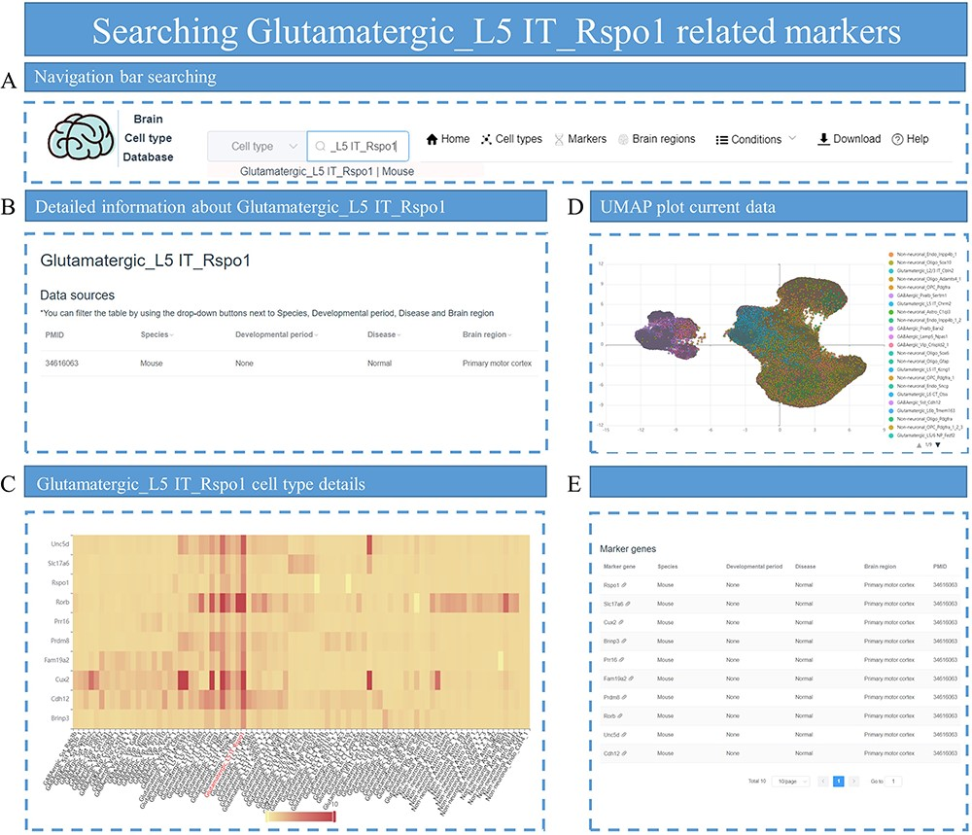
Figure 7. The process of searching for markers related to Glutamatergic_L5 IT_Rspo1. (A) Enter ‘Glutamatergic_L5 ...
Notes:
Figure 7. The process of searching for markers related to Glutamatergic_L5 IT_Rspo1. (A) Enter ‘Glutamatergic_L5 IT_Rspo1’ in the search box on the homepage. (B) The data related to Glutamatergic_L5 IT_Rspo1 are displayed, including parameters such as PMID, species and other conditions. (C) A heatmap displays the distribution of marker genes for Glutamatergic_L5 IT_Rspo1 among different cell types in the specific dataset. (D) The UMAP plot shows all cells in the dataset and provides annotation information on cell types. (E) All marker genes for the Glutamatergic_L5 IT_Rspo1 cell type are listed.
Unless provided in the caption above, the following copyright applies to the content of this slide: © The Author(s) 2023. Published by Oxford University Press.This is an Open Access article distributed under the terms of the Creative Commons Attribution License (https://creativecommons.org/licenses/by/4.0/), which permits unrestricted reuse, distribution, and reproduction in any medium, provided the original work is properly cited.

Slide 8
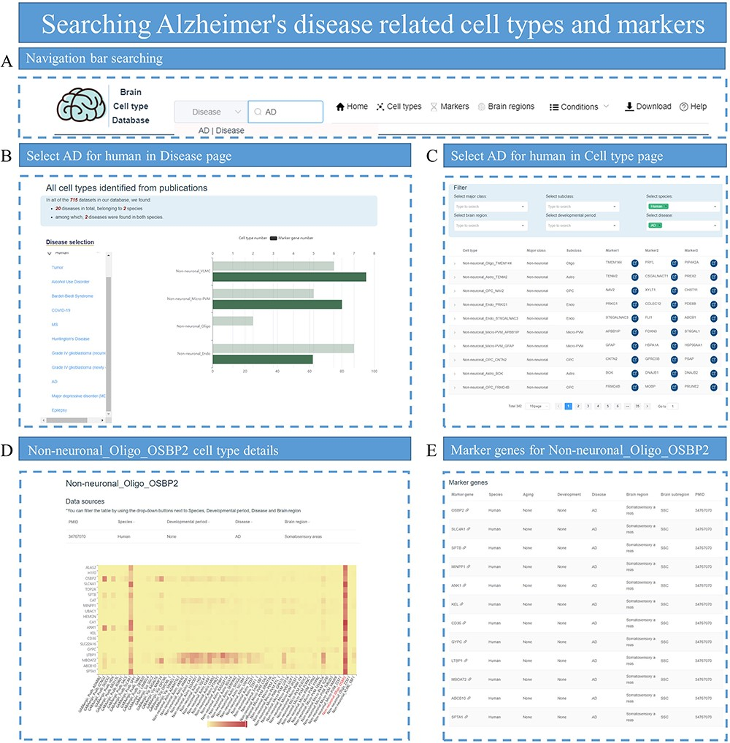
Figure 8. Searching for AD-related cell types and markers. (A) Enter ‘Alzheimer’s disease’ in the search box of the ...
Notes:
Figure 8. Searching for AD-related cell types and markers. (A) Enter ‘Alzheimer’s disease’ in the search box of the homepage. (B) Select AD on the Disease page to view related cell types, which are displayed with the number of identified marker genes. (C) Select species, disease and subclass conditions on the Cell type page to display all eligible cell types. (D) Display the heatmap plot for the expression distribution of top DEGs in cell-type Non-neuronal_Oligo_OSBP2. (E) Provide all marker genes for cell-type Non-neuronal_Oligo_OSBP2.
Unless provided in the caption above, the following copyright applies to the content of this slide: © The Author(s) 2023. Published by Oxford University Press.This is an Open Access article distributed under the terms of the Creative Commons Attribution License (https://creativecommons.org/licenses/by/4.0/), which permits unrestricted reuse, distribution, and reproduction in any medium, provided the original work is properly cited.

