Slide 1
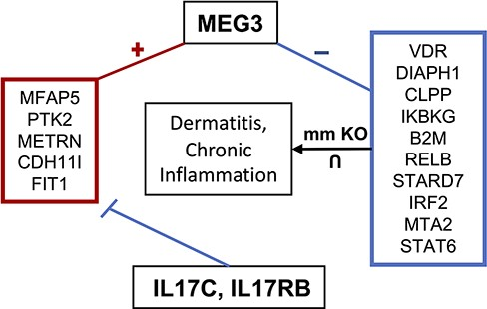
Figure 7. MEG3 involvement in dermatitis and chronic inflammatory response. MEG3 is co-expressed (positively ...
Notes:
Figure 7. MEG3 involvement in dermatitis and chronic inflammatory response. MEG3 is co-expressed (positively correlated) with the genes contained in the left box, which are downregulated by IL17C and IL17RB. Genes in the right box represent the intersection of genes associated with dermatitis and chronic inflammation when knocked out in mice and which are negatively correlated with MEG3.
Unless provided in the caption above, the following copyright applies to the content of this slide: © The Author(s) 2023. Published by Oxford University Press.This is an Open Access article distributed under the terms of the Creative Commons Attribution License (https://creativecommons.org/licenses/by/4.0/), which permits unrestricted reuse, distribution, and reproduction in any medium, provided the original work is properly cited.

