Slide 1
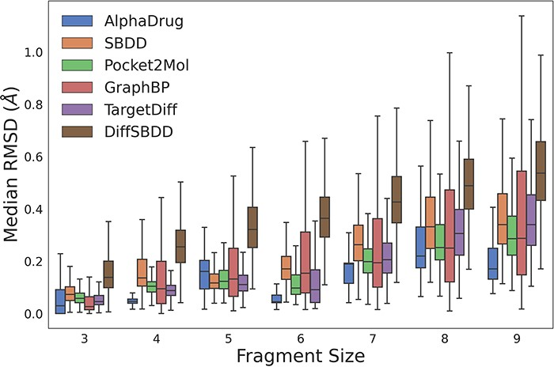
Figure 1. The RMSD values between coordinates of rigid fragments before and after force field optimization. A smaller ...
Notes:
Figure 1. The RMSD values between coordinates of rigid fragments before and after force field optimization. A smaller RMSD value denotes a more reasonable sub-structure. Alt text: The image is a boxplot graph representing the median RMSD across different fragment sizes for various drug discovery methods. Each boxplot corresponds to a specific method, color-coded for identification, with fragment sizes on the x-axis and median RMSD values on the y-axis.
Unless provided in the caption above, the following copyright applies to the content of this slide: © The Author(s) 2023. Published by Oxford University Press.This is an Open Access article distributed under the terms of the Creative Commons Attribution License (https://creativecommons.org/licenses/by/4.0/), which permits unrestricted reuse, distribution, and reproduction in any medium, provided the original work is properly cited.

Slide 2
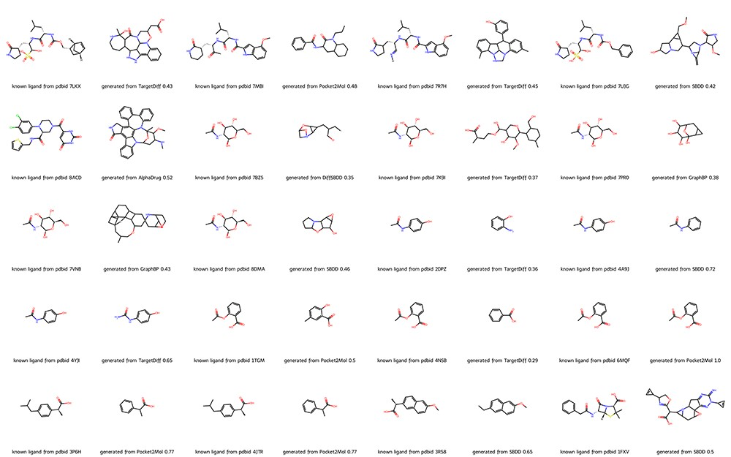
Figure 2. Molecules from DrugGen database with the highest similarity to the original ligands on 20 disease-related ...
Notes:
Figure 2. Molecules from DrugGen database with the highest similarity to the original ligands on 20 disease-related protein targets. The even-numbered columns showcase the original ligand molecules, while the odd-numbered columns display the generated molecules with the highest similarity. The values in the odd-numbered columns indicate the Tanimoto similarity to the original ligand. Alt text: The image depicts a collection of molecular structures, showcasing a comparison between known ligands from PDB entries and those generated by computational models such as TargetDiff, AlphaDrug, Pocket2Mol, GraphBP, DiffSBDD and SBDD. Each row presents a pair of molecules, with the known ligand on the left and the generated ligand on the right, along with the associated PDB codes and model performance metrics, i.e. the Tanimoto similarity.
Unless provided in the caption above, the following copyright applies to the content of this slide: © The Author(s) 2023. Published by Oxford University Press.This is an Open Access article distributed under the terms of the Creative Commons Attribution License (https://creativecommons.org/licenses/by/4.0/), which permits unrestricted reuse, distribution, and reproduction in any medium, provided the original work is properly cited.

Slide 3
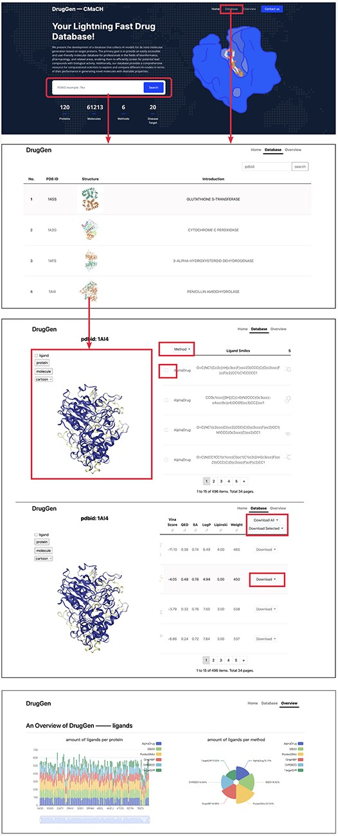
Figure 3. Quick tutorials about utilizing the website to obtain molecules on specific protein targets. We highlighted ...
Notes:
Figure 3. Quick tutorials about utilizing the website to obtain molecules on specific protein targets. We highlighted main interfaces with rectangular boxes. The bottom image displays part of the ‘overview’ page, which delivers a comprehensive evaluation of each method. Alt text: The image shows a guide for navigating the database, detailing the steps to search for and visualize the binding pose between a molecule and a target protein.
Unless provided in the caption above, the following copyright applies to the content of this slide: © The Author(s) 2023. Published by Oxford University Press.This is an Open Access article distributed under the terms of the Creative Commons Attribution License (https://creativecommons.org/licenses/by/4.0/), which permits unrestricted reuse, distribution, and reproduction in any medium, provided the original work is properly cited.

