Slide 1
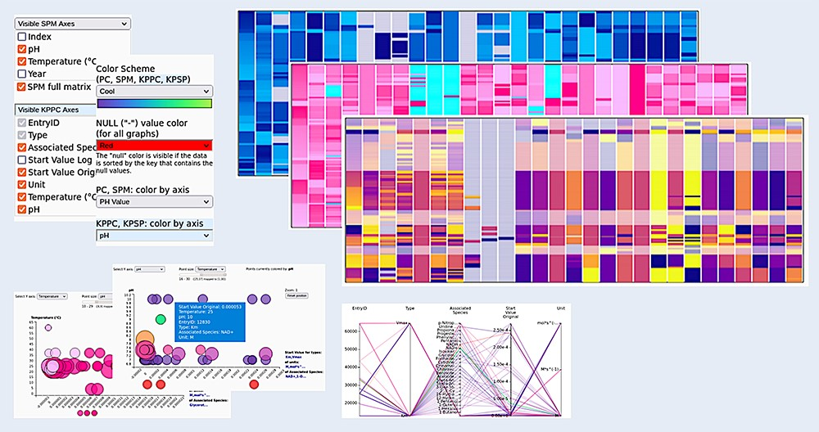
Figure 8. Customizing the graphs. All graphs can be visually adjusted by determining what exactly is shown within the ...
Notes:
Figure 8. Customizing the graphs. All graphs can be visually adjusted by determining what exactly is shown within the graphs (choose the axes), by reordering the data and by selecting different color schemes for the visualizations, making the appearance adjustable to the needs of the user.
Unless provided in the caption above, the following copyright applies to the content of this slide: © The Author(s) 2023. Published by Oxford University Press.This is an Open Access article distributed under the terms of the Creative Commons Attribution License (https://creativecommons.org/licenses/by/4.0/), which permits unrestricted reuse, distribution, and reproduction in any medium, provided the original work is properly cited.

