Slide 1
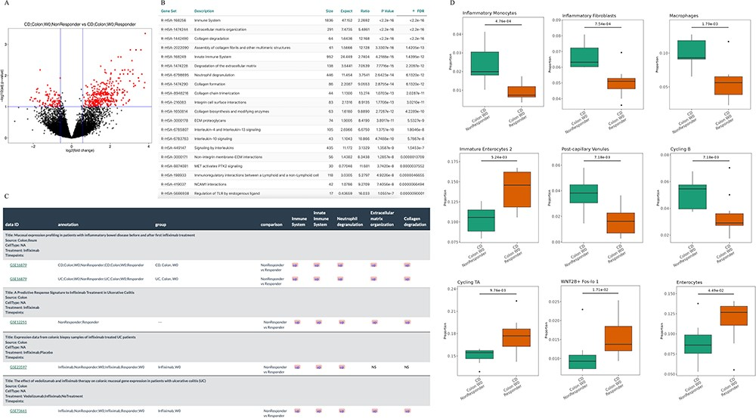
Figure 2. Understanding the infliximab resistance molecular and cellular mechanisms. (A) Volcano plot of differentially ...
Notes:
Figure 2. Understanding the infliximab resistance molecular and cellular mechanisms. (A) Volcano plot of differentially expressed genes between non-responders and responders at baseline in GSE16879 CD colon samples. (B) Top 20 enriched Reactome pathways based on the up-regulated genes from (A). (C) Comparison of five representative Reactome-enriched pathways from (B) in five non-responder vs responder comparisons from four infliximab-treated IBD datasets. (D) Significant cell types between non-responders and responders at baseline in GSE16879 CD colon samples.
Unless provided in the caption above, the following copyright applies to the content of this slide: © The Author(s) 2024. Published by Oxford University Press.This is an Open Access article distributed under the terms of the Creative Commons Attribution License (https://creativecommons.org/licenses/by/4.0/), which permits unrestricted reuse, distribution, and reproduction in any medium, provided the original work is properly cited.

