Slide 1
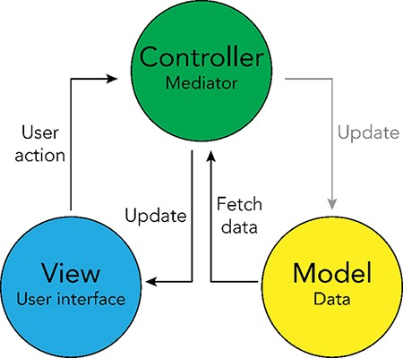
Figure 4. Model-View-Controller (MVC) software design pattern used for the UKB Health Disparities Browser. The ...
Notes:
Figure 4. Model-View-Controller (MVC) software design pattern used for the UKB Health Disparities Browser. The schematic showing the MVC software design pattern used to develop the interactive web server. Parts of the pattern that are not applicable to the current browser are grayed out.
Unless provided in the caption above, the following copyright applies to the content of this slide: Published by Oxford University Press 2023. This work is written by (a) US Government employee(s) and is in the public domain in the US.This work is written by (a) US Government employee(s) and is in the public domain in the US.

Slide 2
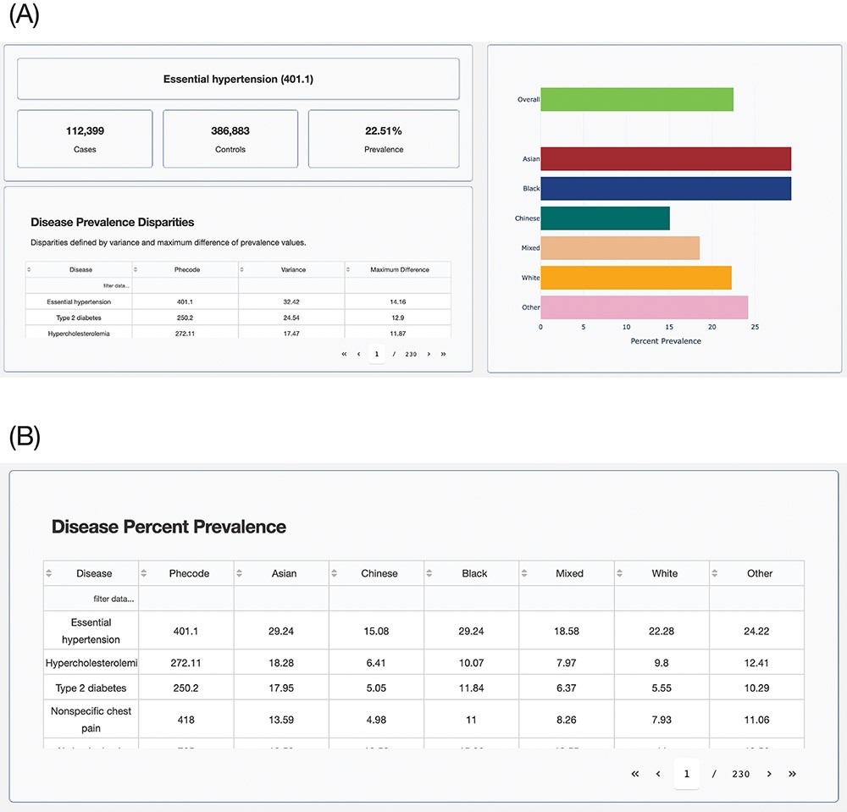
Figure 5. UKB Health Disparity Browser. Screenshots of the UKB Health Disparity Browser showing (A) disease phenotype ...
Notes:
Figure 5. UKB Health Disparity Browser. Screenshots of the UKB Health Disparity Browser showing (A) disease phenotype prevalence for different ethnic groups sorted by disparity score and (B) table of disease prevalence for each ethnic group.
Unless provided in the caption above, the following copyright applies to the content of this slide: Published by Oxford University Press 2023. This work is written by (a) US Government employee(s) and is in the public domain in the US.This work is written by (a) US Government employee(s) and is in the public domain in the US.

Slide 3
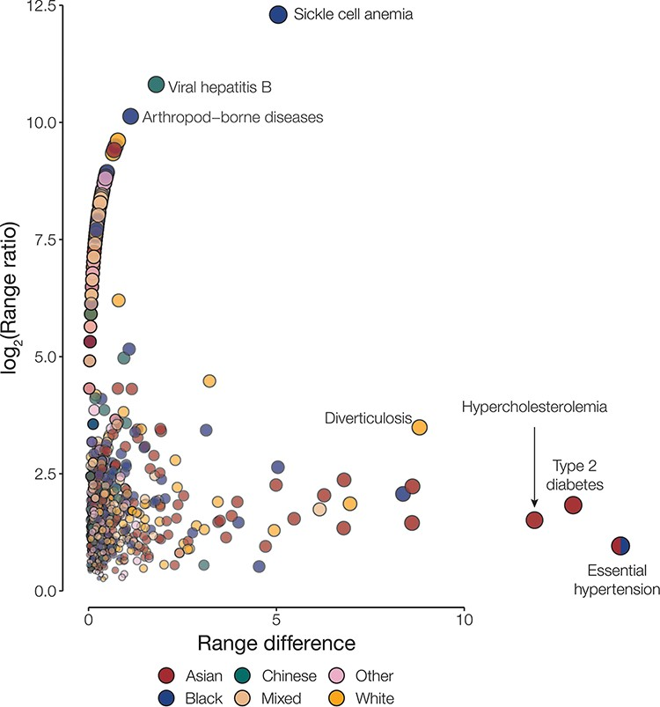
Figure 1. Disease disparities for ethnic groups. Disparities are quantified by the range ratio (y-axis) and the range ...
Notes:
Figure 1. Disease disparities for ethnic groups. Disparities are quantified by the range ratio (y-axis) and the range difference (x-axis) as described in the Methods section. Each point is a disease phenotype and is colored to indicate the ethnic groups with the highest prevalence for that phenotype. The size and opacity of each point are scaled by the Euclidean distance from the origin.
Unless provided in the caption above, the following copyright applies to the content of this slide: Published by Oxford University Press 2023. This work is written by (a) US Government employee(s) and is in the public domain in the US.This work is written by (a) US Government employee(s) and is in the public domain in the US.

Slide 4
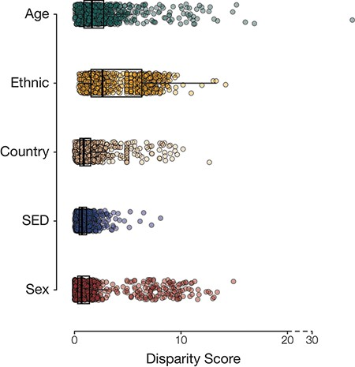
Figure 2. Population group disease disparity scores. The distributions of disease disparity scores for each population ...
Notes:
Figure 2. Population group disease disparity scores. The distributions of disease disparity scores for each population group attribute are shown. Each point is a disease phenotype plotted with its group-specific disparity score.
Unless provided in the caption above, the following copyright applies to the content of this slide: Published by Oxford University Press 2023. This work is written by (a) US Government employee(s) and is in the public domain in the US.This work is written by (a) US Government employee(s) and is in the public domain in the US.

Slide 5
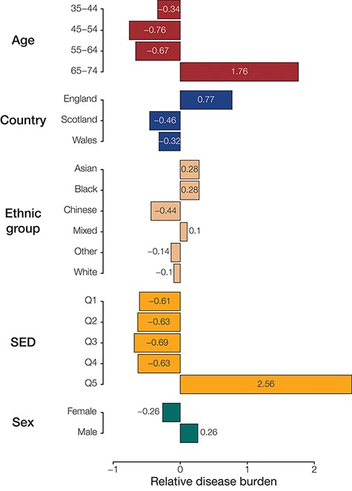
Figure 3. Population (sub)group disease burdens. Relative disease burden values are shown for population groups’ ...
Notes:
Figure 3. Population (sub)group disease burdens. Relative disease burden values are shown for population groups’ constituent subgroups.
Unless provided in the caption above, the following copyright applies to the content of this slide: Published by Oxford University Press 2023. This work is written by (a) US Government employee(s) and is in the public domain in the US.This work is written by (a) US Government employee(s) and is in the public domain in the US.

