Slide 1
Figure 1. The visualization module of the SABIO-RK database. First three graphs (the heat map overview, the parallel ...
Notes:
Figure 1. The visualization module of the SABIO-RK database. First three graphs (the heat map overview, the parallel coordinates and the scatter plot matrix with histograms) are representing the entry-based graphs. Bottom two framed graphs are kinetic parameters–based graphs.
Unless provided in the caption above, the following copyright applies to the content of this slide: © The Author(s) 2023. Published by Oxford University Press.This is an Open Access article distributed under the terms of the Creative Commons Attribution License (https://creativecommons.org/licenses/by/4.0/), which permits unrestricted reuse, distribution, and reproduction in any medium, provided the original work is properly cited.

Slide 2
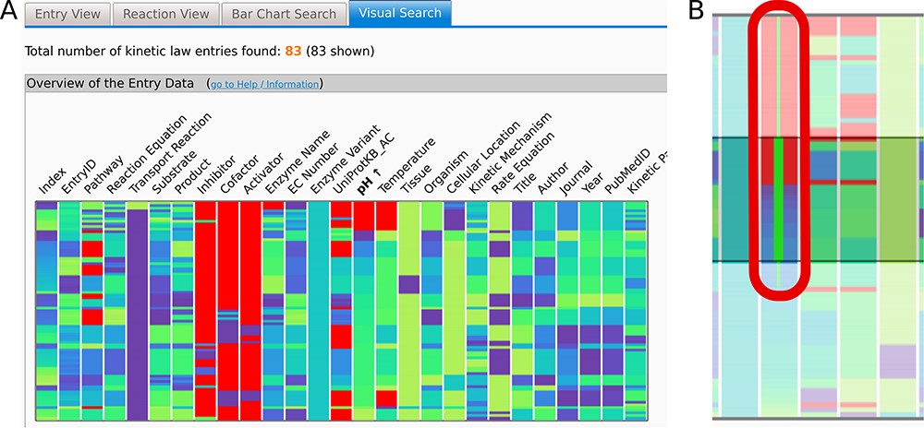
Figure 2. (A) The Overview heat map graph. Attribute names are given above the graph. Data can be sorted by any of the ...
Notes:
Figure 2. (A) The Overview heat map graph. Attribute names are given above the graph. Data can be sorted by any of the attributes. Here, the data are sorted by pH values. One horizontal line represents one entry of the data. Data can be selected by clicking or brushing. (B) Brushing extends the selection to capture all of the brushed border values (thin green line in (B)) including all entries with the same highlighted property (e.g. pH value 7.0). Selected data are highlighted in all of the graphs. Axes can be added or removed and rearranged as desired as well as the used color schemes. Here, the null values are denoted in red, while a ‘cool’ color scheme ranging from dark purple to lime is used per attribute or axis.
Unless provided in the caption above, the following copyright applies to the content of this slide: © The Author(s) 2023. Published by Oxford University Press.This is an Open Access article distributed under the terms of the Creative Commons Attribution License (https://creativecommons.org/licenses/by/4.0/), which permits unrestricted reuse, distribution, and reproduction in any medium, provided the original work is properly cited.

Slide 3
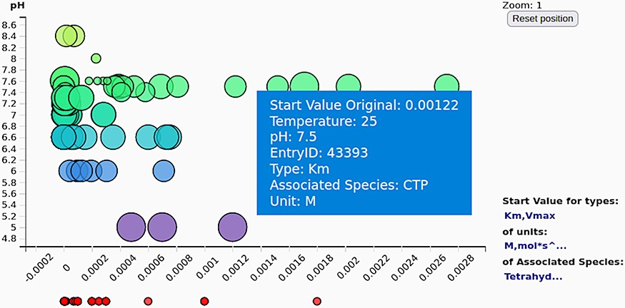
Figure 6. The scatter plot of the kinetic parameter values (here shown against the pH values) gives an overview of the ...
Notes:
Figure 6. The scatter plot of the kinetic parameter values (here shown against the pH values) gives an overview of the exact values of the selected kinetic parameters (often not deductible from the axis tick denotations on the parallel coordinates).
Unless provided in the caption above, the following copyright applies to the content of this slide: © The Author(s) 2023. Published by Oxford University Press.This is an Open Access article distributed under the terms of the Creative Commons Attribution License (https://creativecommons.org/licenses/by/4.0/), which permits unrestricted reuse, distribution, and reproduction in any medium, provided the original work is properly cited.

Slide 4
Figure 7. Schematics of searching using the new visualization and query composition for the SABIO-RK data.
Notes:
Figure 7. Schematics of searching using the new visualization and query composition for the SABIO-RK data.
Unless provided in the caption above, the following copyright applies to the content of this slide: © The Author(s) 2023. Published by Oxford University Press.This is an Open Access article distributed under the terms of the Creative Commons Attribution License (https://creativecommons.org/licenses/by/4.0/), which permits unrestricted reuse, distribution, and reproduction in any medium, provided the original work is properly cited.

Slide 5
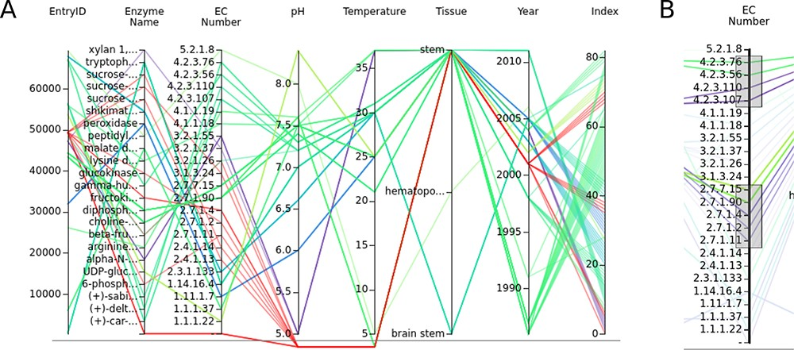
Figure 3. (A) The parallel coordinates graph of the entry data. Attribute names are given above the graph. One entry ...
Notes:
Figure 3. (A) The parallel coordinates graph of the entry data. Attribute names are given above the graph. One entry represents one line on the graph. Null values are under the lower line. (B) Data can be selected by brushing the axes.
Unless provided in the caption above, the following copyright applies to the content of this slide: © The Author(s) 2023. Published by Oxford University Press.This is an Open Access article distributed under the terms of the Creative Commons Attribution License (https://creativecommons.org/licenses/by/4.0/), which permits unrestricted reuse, distribution, and reproduction in any medium, provided the original work is properly cited.

Slide 6
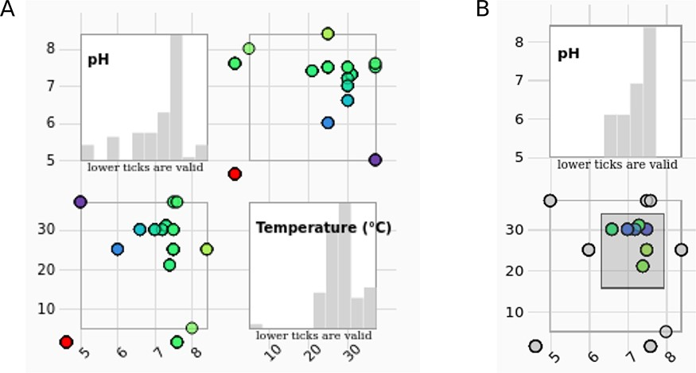
Figure 4. (A) The scatter plot matrix of the entry data with histograms is showing measurement conditions (pH values in ...
Notes:
Figure 4. (A) The scatter plot matrix of the entry data with histograms is showing measurement conditions (pH values in correlation with temperature) of the selected entries. (B) The data range can be selected by brushing on any of the scatter plots. Histograms change accordingly.
Unless provided in the caption above, the following copyright applies to the content of this slide: © The Author(s) 2023. Published by Oxford University Press.This is an Open Access article distributed under the terms of the Creative Commons Attribution License (https://creativecommons.org/licenses/by/4.0/), which permits unrestricted reuse, distribution, and reproduction in any medium, provided the original work is properly cited.

Slide 7
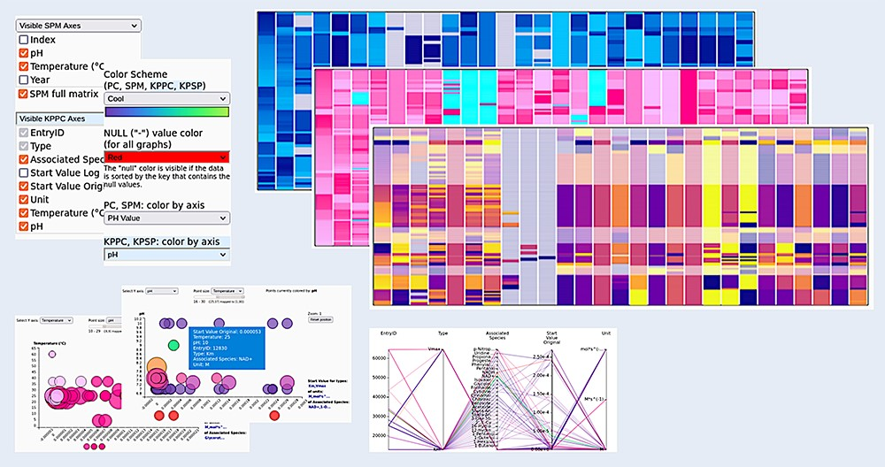
Figure 8. Customizing the graphs. All graphs can be visually adjusted by determining what exactly is shown within the ...
Notes:
Figure 8. Customizing the graphs. All graphs can be visually adjusted by determining what exactly is shown within the graphs (choose the axes), by reordering the data and by selecting different color schemes for the visualizations, making the appearance adjustable to the needs of the user.
Unless provided in the caption above, the following copyright applies to the content of this slide: © The Author(s) 2023. Published by Oxford University Press.This is an Open Access article distributed under the terms of the Creative Commons Attribution License (https://creativecommons.org/licenses/by/4.0/), which permits unrestricted reuse, distribution, and reproduction in any medium, provided the original work is properly cited.

Slide 8
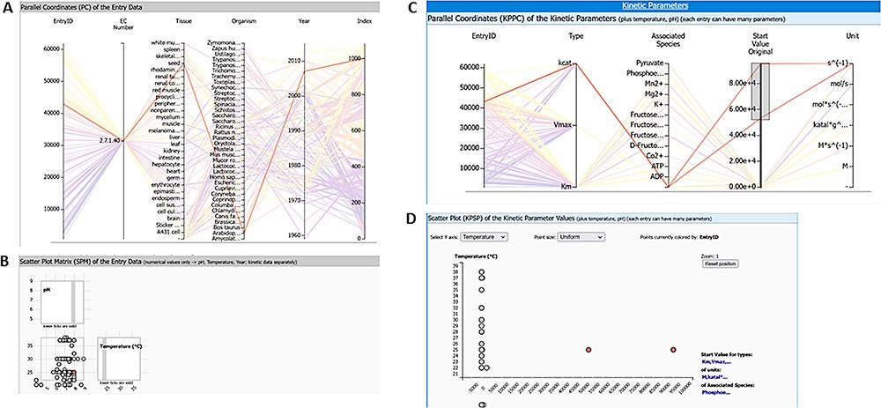
Figure 9. Query results for enzyme pyruvate kinase and reaction ‘ATP + Pyruvate = ADP + Phosphoenolpyruvate’ (query ...
Notes:
Figure 9. Query results for enzyme pyruvate kinase and reaction ‘ATP + Pyruvate = ADP + Phosphoenolpyruvate’ (query term: ECNumber:”2.7.1.40” AND SabioReactionID:”9”) with two highlighted kinetic parameter outlier values: (A) parallel coordinates of entry data, (B) scatter plot matrix of entry data, (C) parallel coordinates of kinetic parameters, and (D) scatter plot of kinetic parameters.
Unless provided in the caption above, the following copyright applies to the content of this slide: © The Author(s) 2023. Published by Oxford University Press.This is an Open Access article distributed under the terms of the Creative Commons Attribution License (https://creativecommons.org/licenses/by/4.0/), which permits unrestricted reuse, distribution, and reproduction in any medium, provided the original work is properly cited.

Slide 9
Figure 5. (A) Parallel coordinates of the kinetic parameters. (B) Data can be selected by brushing the axes. This ...
Notes:
Figure 5. (A) Parallel coordinates of the kinetic parameters. (B) Data can be selected by brushing the axes. This selection automatically selects the data on the scatter plot. (C) The scatter plot helps to keep an overview of the exact values of the selected kinetic parameters.
Unless provided in the caption above, the following copyright applies to the content of this slide: © The Author(s) 2023. Published by Oxford University Press.This is an Open Access article distributed under the terms of the Creative Commons Attribution License (https://creativecommons.org/licenses/by/4.0/), which permits unrestricted reuse, distribution, and reproduction in any medium, provided the original work is properly cited.

