Slide 1
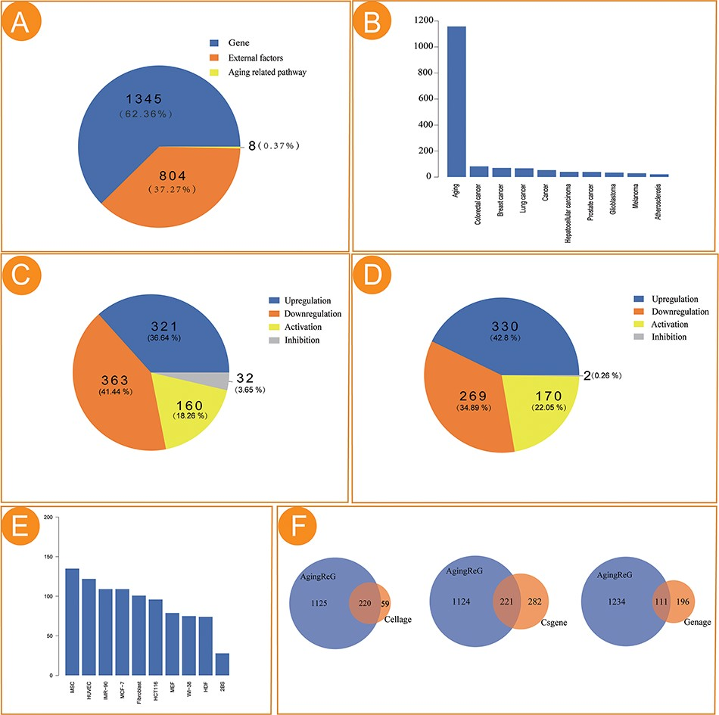
Figure 2. Statistical analysis of the aging factors in AgingReG. (A) The number of aging factors in AgingReG. (B) The ...
Notes:
Figure 2. Statistical analysis of the aging factors in AgingReG. (A) The number of aging factors in AgingReG. (B) The distribution of the pathological phenotypes associated with aging factors in AgingReG. The top 10 extensively studied pathological phenotypes recorded in AgingReG. (C) The number of aging gene–related regulatory relationship entries. (D) The number of external factor–related regulatory relationship entries. (E) The top 10 frequently studied cells in aging research in AgingReG. (F) The comparison between AgingReG and Cellage, between AgingReG and CSGene and between AgingReG and GenAge and the number of overlapping data points.
Unless provided in the caption above, the following copyright applies to the content of this slide: © The Author(s) 2023. Published by Oxford University Press.This is an Open Access article distributed under the terms of the Creative Commons Attribution License (https://creativecommons.org/licenses/by/4.0/), which permits unrestricted reuse, distribution, and reproduction in any medium, provided the original work is properly cited.

