Slide 1
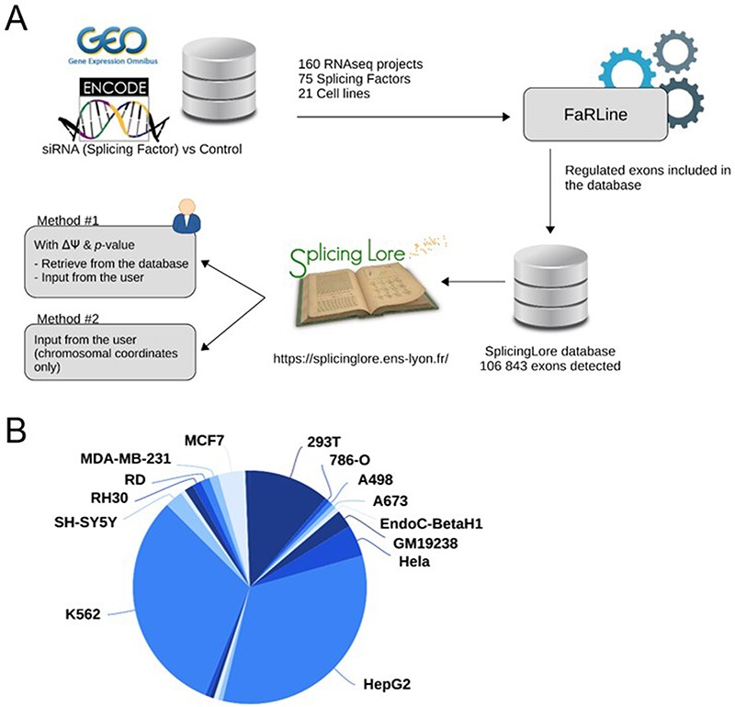
Figure 1. General features of SplicingLore. (A) Outline of the SplicingLore workflow. RNA-seq datasets from GEO and ...
Notes:
Figure 1. General features of SplicingLore. (A) Outline of the SplicingLore workflow. RNA-seq datasets from GEO and ENCODE databases were uniformly processed with FaRLine to generate lists of alternative exons regulated by 75 SFs in 21 human cell lines. These datasets can be used to compute correlation scores of exon regulation with a list of exons of interest, which is either retrieved from the database or provided by the user (Query Method 1). The user can alternatively query SplicingLore with a list of exons associated only with their chromosomal coordinates (Method 2). In the latter case, the list of exons can include or not a ΔPSI and P-value. (B) Diagram showing the repartition of the SplicingLore datasets between cell lines. Alt text for Figure 1: Description of the SplicingLore workflow and different methods of analysis, featuring the repartition of the datasets between different cell lines.
Unless provided in the caption above, the following copyright applies to the content of this slide: © The Author(s) 2023. Published by Oxford University Press.This is an Open Access article distributed under the terms of the Creative Commons Attribution License (https://creativecommons.org/licenses/by/4.0/), which permits unrestricted reuse, distribution, and reproduction in any medium, provided the original work is properly cited.

Slide 2
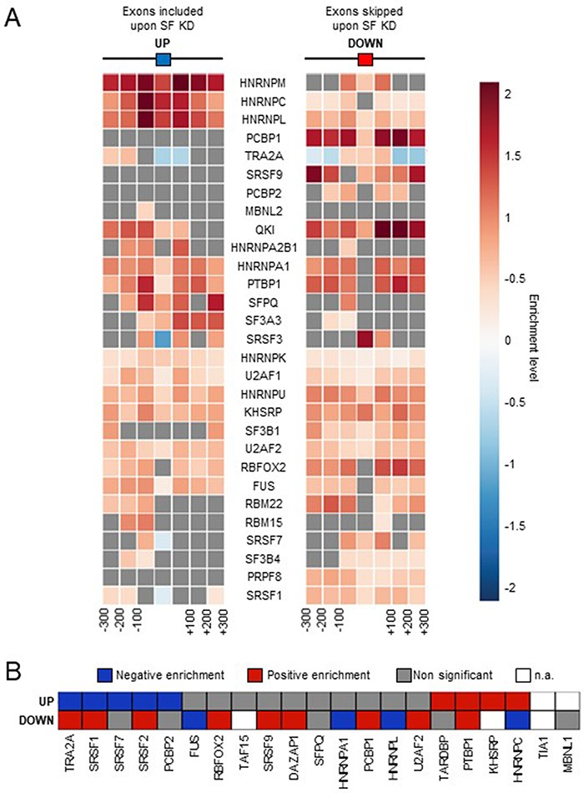
Figure 2. Comparison with SF binding sites. (A) Enrichment of SF binding sites (based on CLIP-seq data) at exons that ...
Notes:
Figure 2. Comparison with SF binding sites. (A) Enrichment of SF binding sites (based on CLIP-seq data) at exons that are up- or down-regulated by the corresponding factor and in their flanking regions. Each square on both sides of the exon represents a 100 nucleotide window upstream and upstream of the exon. (B) Enrichment of SF-specific binding sequences at exons (±200 nucleotides) that are up- or down-regulated by the corresponding factor. Not applicable (n.a.): less than 100 exons were identified by FaRLine as more included or excluded upon knockdown of the corresponding SF. Alt text for Figure 2: Heatmaps showing the relative enrichment of SF binding sites or binding motifs around exons that are up- or down-regulated by the same factor.
Unless provided in the caption above, the following copyright applies to the content of this slide: © The Author(s) 2023. Published by Oxford University Press.This is an Open Access article distributed under the terms of the Creative Commons Attribution License (https://creativecommons.org/licenses/by/4.0/), which permits unrestricted reuse, distribution, and reproduction in any medium, provided the original work is properly cited.

Slide 3
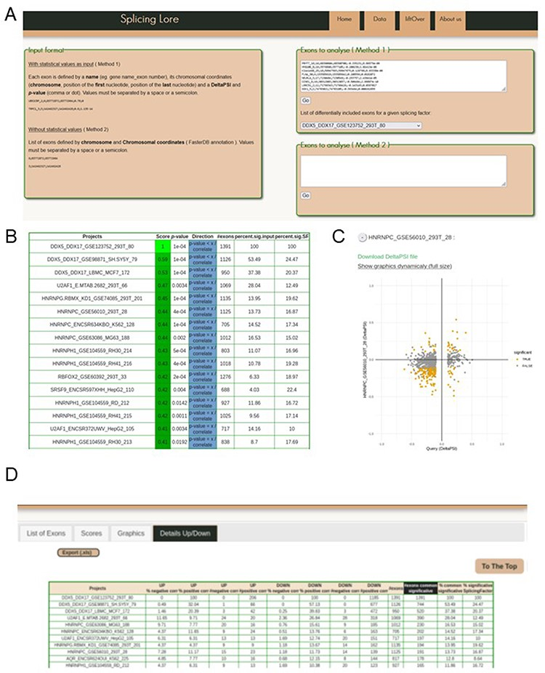
Figure 3. Visualization of the SplicingLore web interface. (A) View of the home page, with the instructions to prepare ...
Notes:
Figure 3. Visualization of the SplicingLore web interface. (A) View of the home page, with the instructions to prepare the input list of exons and the query window. This includes the drop-down menu that allows to retrieve a given list of SF-regulated exons from the database. (B) View of the top of the main output file, showing for each dataset the different correlation parameters with the query list (here the exons regulated by DDX5/DDX17 in 293T cells). The Score and associated P-value for positive or negative correlation are provided for each dataset of the database, along with the total number of exons in the corresponding dataset and the fraction of common exons between the compared datasets, relative to the query list or to the tested dataset. (C) The correlation graph of the ∆PSI values for common exons from the query list and one of the stored datasets. Coloured dots represent exons that are significantly regulated by both SF. The file containing the corresponding ∆PSI values for these exons can be downloaded here. (D) View of the top of the detailed output file, which provides the number (#) and fraction (%) of shared exons between the query and the dataset, separated in up-regulated and down-regulated subclasses of exons. Alt text for Figure 3: Screenshots of the SplicingLore web interface and output files.
Unless provided in the caption above, the following copyright applies to the content of this slide: © The Author(s) 2023. Published by Oxford University Press.This is an Open Access article distributed under the terms of the Creative Commons Attribution License (https://creativecommons.org/licenses/by/4.0/), which permits unrestricted reuse, distribution, and reproduction in any medium, provided the original work is properly cited.

Slide 4
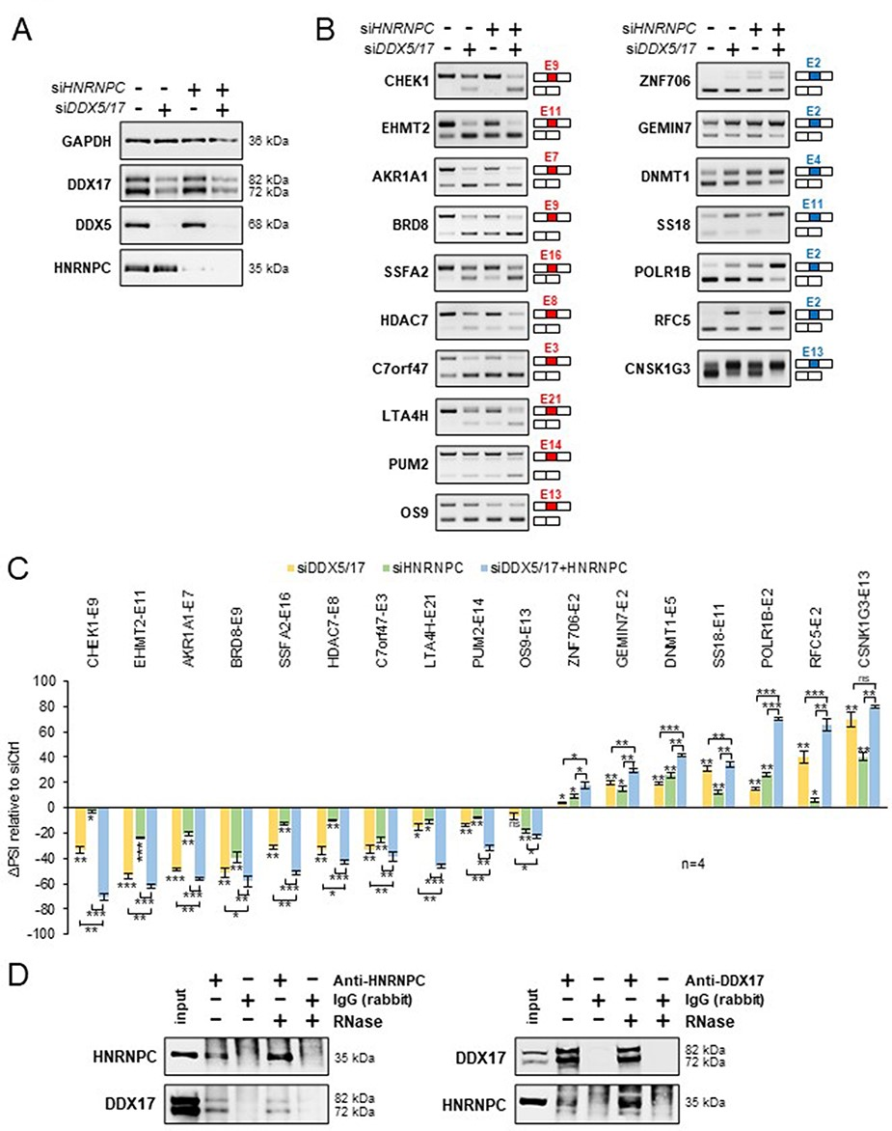
Figure 4. Validation of a functional relationship between DDX5/DDX17 and HNRNPC. (A) Western blot showing the ...
Notes:
Figure 4. Validation of a functional relationship between DDX5/DDX17 and HNRNPC. (A) Western blot showing the expression of DDX5, DDX17 and HNRNPC following the treatment with siRNA targeted against luciferase (negative control), DDX5/DDX17 and HNRNPC. Quantification of this experiment is shown in Supplementary Figure S7A. (B) RT-PCR analysis showing the inclusion of a selection of alternative exons after the depletion of DDX5/DDX17 and/or HNRNPC in 293T cells. The corresponding gene and exon number (according to FasterDB annotation) are indicated. Exons down-regulated and up-regulated upon SF knockdown are shown in the left and right column, respectively. (C) Quantification of the RT-PCR experiment. The indicated ΔPSI values correspond to the difference between the PSI value of each depleted sample and the control sample. The statistical comparison between each condition (including the unshown control condition) was calculated using a one-way analysis of variance (ANOVA) (Holm–Sidak’s multiple comparison tests: *P < 0.05, **P < 0.01, ***P < 0.001). (D) Co-immunoprecipitation assays between endogenous HNRNPC and DDX17 in 293T cells, in the absence of presence of RNase A. Alt text for Figure 4: Experiments validating the cooperative effect of DDX5/DDX17 helicases and HNRNPC on alternative exon inclusion and the interaction between DDX17 and HNRNPC in HEK293 cells.
Unless provided in the caption above, the following copyright applies to the content of this slide: © The Author(s) 2023. Published by Oxford University Press.This is an Open Access article distributed under the terms of the Creative Commons Attribution License (https://creativecommons.org/licenses/by/4.0/), which permits unrestricted reuse, distribution, and reproduction in any medium, provided the original work is properly cited.

