Slide 1
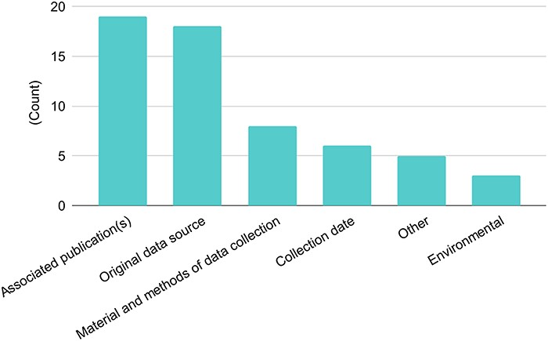
Figure 2. Types of metadata shared with other databases. There were 26 responses to this question. Singleton answers ...
Notes:
Figure 2. Types of metadata shared with other databases. There were 26 responses to this question. Singleton answers were collated into the ‘Other’ category, and metadata categories are abbreviated for this figure.
Unless provided in the caption above, the following copyright applies to the content of this slide: Published by Oxford University Press 2023. This work is written by (a) US Government employee(s) and is in the public domain in the US.This work is written by (a) US Government employee(s) and is in the public domain in the US.

