Slide 1
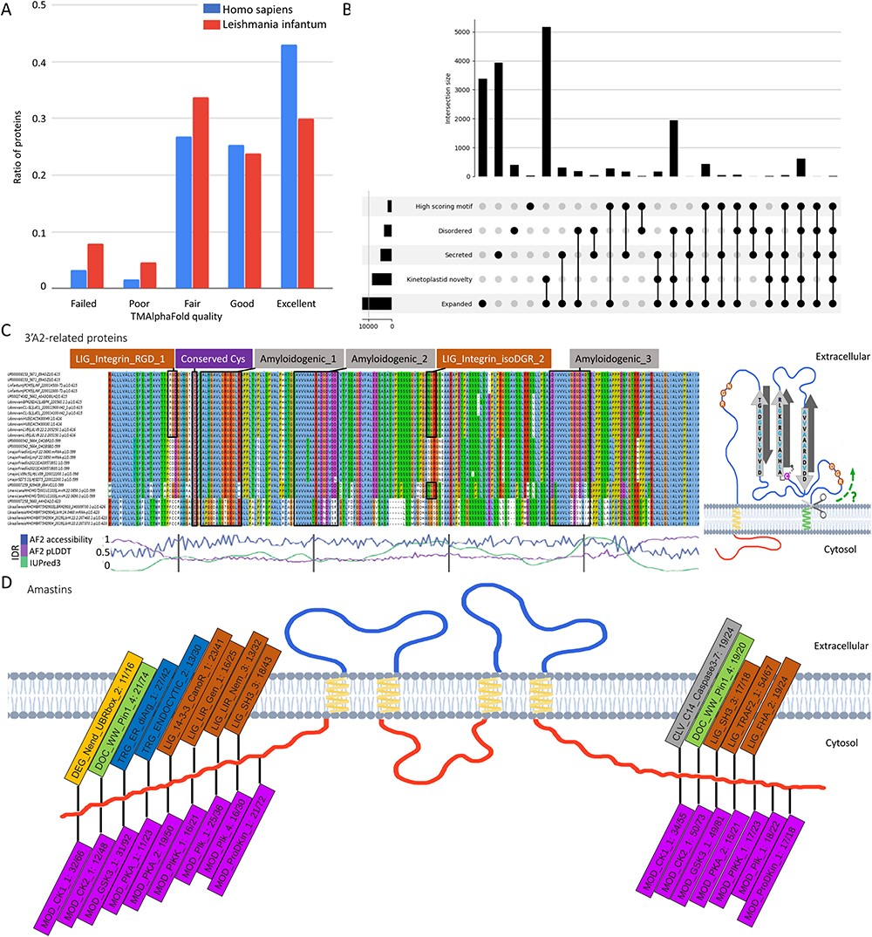
Figure 3. A: Distribution of membrane protein quality levels of AlphaFold structure in Homo sapiens and Leishmania ...
Notes:
Figure 3. A: Distribution of membrane protein quality levels of AlphaFold structure in Homo sapiens and Leishmania infantum. B: Upset diagram of proteins that are (1) secreted, (2) novel kinetoplastid, (3) expanded (or new) in Leishmania, (4) disordered, (5) contain candidate SLiMs. C: left: Multiple Sequence Alignment of 3ʹA2 related proteins (alignment is available under UniProt AC: E9AGZ3). Amyloidogenic regions, conserved cysteine and integrin-binding motifs are highlighted; right: proposed topology of 3ʹA2 related proteins. D: Frequent SLiMs in the cytoplasmic tail regions of amastins (the numbers denote the unique/total occurrences).
Unless provided in the caption above, the following copyright applies to the content of this slide: © The Author(s) 2024. Published by Oxford University Press.This is an Open Access article distributed under the terms of the Creative Commons Attribution License (https://creativecommons.org/licenses/by/4.0/), which permits unrestricted reuse, distribution, and reproduction in any medium, provided the original work is properly cited.

