Slide 1
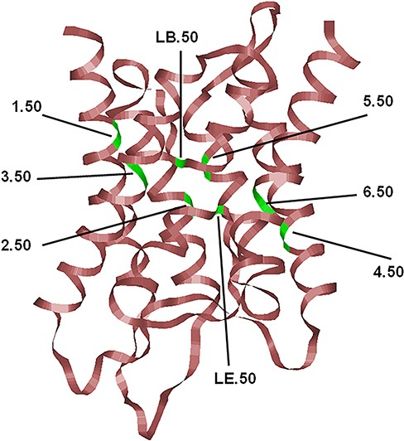
Figure 1. The typical hour-glass fold adopted by MIP family members shown here corresponds to the human AQP4 (PDB ID: ...
Notes:
Figure 1. The typical hour-glass fold adopted by MIP family members shown here corresponds to the human AQP4 (PDB ID: 3GD8; resolution: 1.8 Å). Only the backbone is shown in ribbon representation. The most conserved residue in each TM segment (TM1–TM6) and the two half-helices (LB and LE) are displayed and the locations of the conserved residues are indicated, and their generic numbers are also shown. In human AQP4, they correspond to E44 (1.50), G78 (2.50), N97 (LB.50), Q122 (3.50), E163 (4.50), G194 (5.50), N213 (LE.50) and P237 (6.50), and the residue numbering corresponds to the PDB ID: 3GD8. For details about the generic numbering scheme in AQPs, see the main text.
Unless provided in the caption above, the following copyright applies to the content of this slide: © The Author(s) 2023. Published by Oxford University Press.This is an Open Access article distributed under the terms of the Creative Commons Attribution License (https://creativecommons.org/licenses/by/4.0/), which permits unrestricted reuse, distribution, and reproduction in any medium, provided the original work is properly cited.

Slide 2
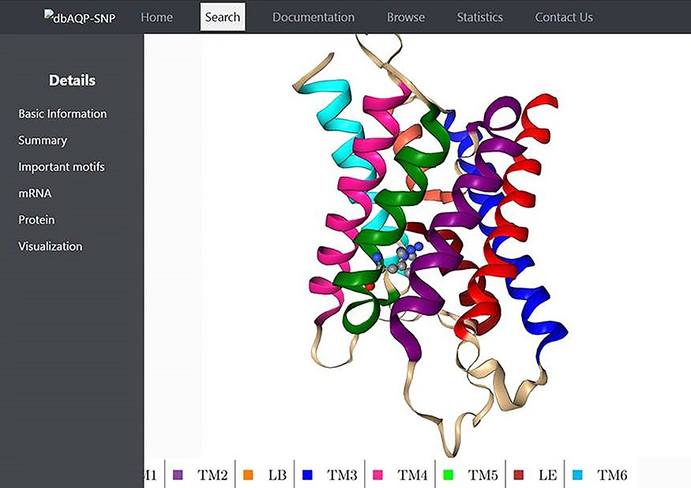
Figure 2. Molecular plot of a specific human AQP with the residue in which missense SNPs occurred shown in ...
Notes:
Figure 2. Molecular plot of a specific human AQP with the residue in which missense SNPs occurred shown in ball-and-stick representation. The helices (TM1–TM6) and the half-helices (LB and LE) are displayed in different colors.
Unless provided in the caption above, the following copyright applies to the content of this slide: © The Author(s) 2023. Published by Oxford University Press.This is an Open Access article distributed under the terms of the Creative Commons Attribution License (https://creativecommons.org/licenses/by/4.0/), which permits unrestricted reuse, distribution, and reproduction in any medium, provided the original work is properly cited.

Slide 3
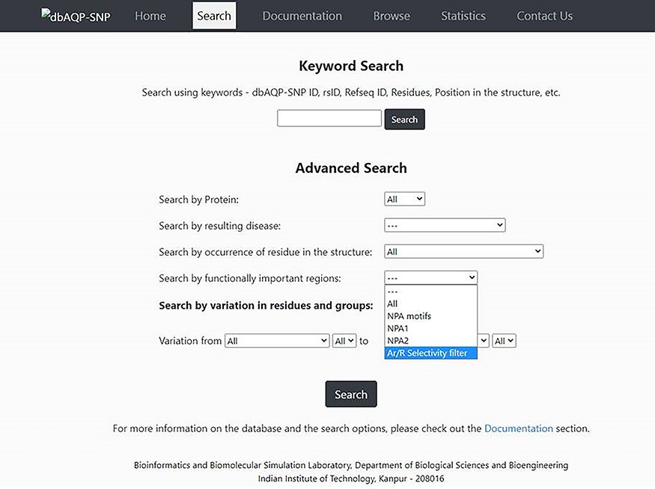
Figure 3. Screenshot of the dbAQP-SNP Search page.
Notes:
Figure 3. Screenshot of the dbAQP-SNP Search page.
Unless provided in the caption above, the following copyright applies to the content of this slide: © The Author(s) 2023. Published by Oxford University Press.This is an Open Access article distributed under the terms of the Creative Commons Attribution License (https://creativecommons.org/licenses/by/4.0/), which permits unrestricted reuse, distribution, and reproduction in any medium, provided the original work is properly cited.

