Slide 1
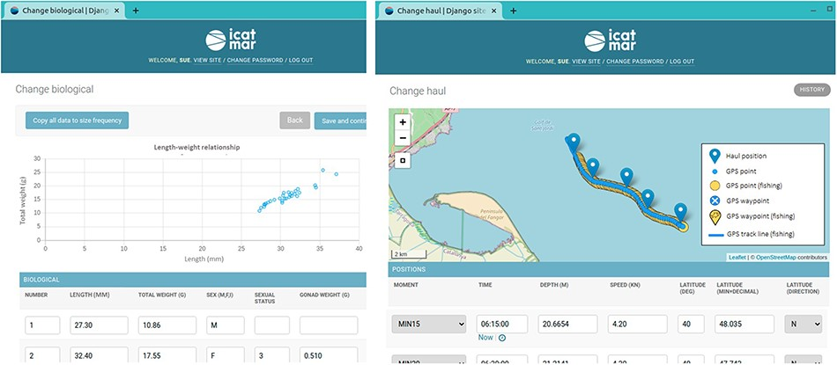
Figure 3. Examples of the data input website displaying interactive charts and maps to perform visual validations of ...
Notes:
Figure 3. Examples of the data input website displaying interactive charts and maps to perform visual validations of the entered data. The scatter chart displays the individuals’ lengths and weights to detect possible outliers. The interactive chart is displaying the onboard positions (blue pointers), together with the uploaded GPS points (blue circles) and the GPS points detected as fishing (yellow circles).
Unless provided in the caption above, the following copyright applies to the content of this slide: © The Author(s) 2023. Published by Oxford University Press.This is an Open Access article distributed under the terms of the Creative Commons Attribution License (https://creativecommons.org/licenses/by/4.0/), which permits unrestricted reuse, distribution, and reproduction in any medium, provided the original work is properly cited.

