Slide 1
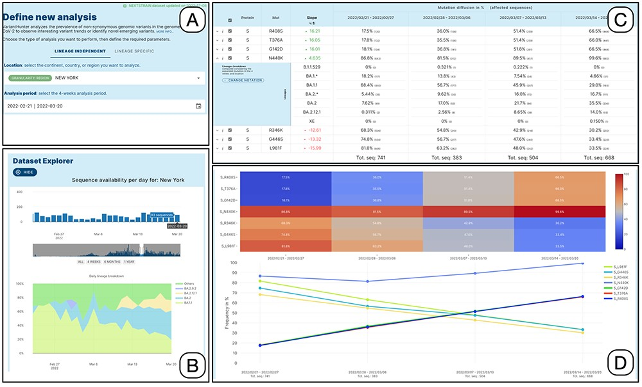
Figure 2. Lineage-independent analysis of sequences collected in the New York state between February 21 and 20 March ...
Notes:
Figure 2. Lineage-independent analysis of sequences collected in the New York state between February 21 and 20 March 2022—corresponding to the transition from Omicron 1 (BA.1) to Omicron 2 (BA.2). Panel A: setting of the analysis parameters; Panel B: overview of the prevalence SARS-CoV-2 lineages; Panel C: amino acid changes with the highest change in prevalence (for the amino acid change N440K on the Spike protein, the lineage breakdown is shown); Panel D: diffusion heatmap and line plot of the prevalence of the changes selected in the table. Three of them have a similar highly increasing trend, N440K is increasing at a slower rate starting from a higher prevalence, whereas the last three are decreasing at various similar rates.
Unless provided in the caption above, the following copyright applies to the content of this slide: © The Author(s) 2023. Published by Oxford University Press.This is an Open Access article distributed under the terms of the Creative Commons Attribution License (https://creativecommons.org/licenses/by/4.0/), which permits unrestricted reuse, distribution, and reproduction in any medium, provided the original work is properly cited.

