Slide 1
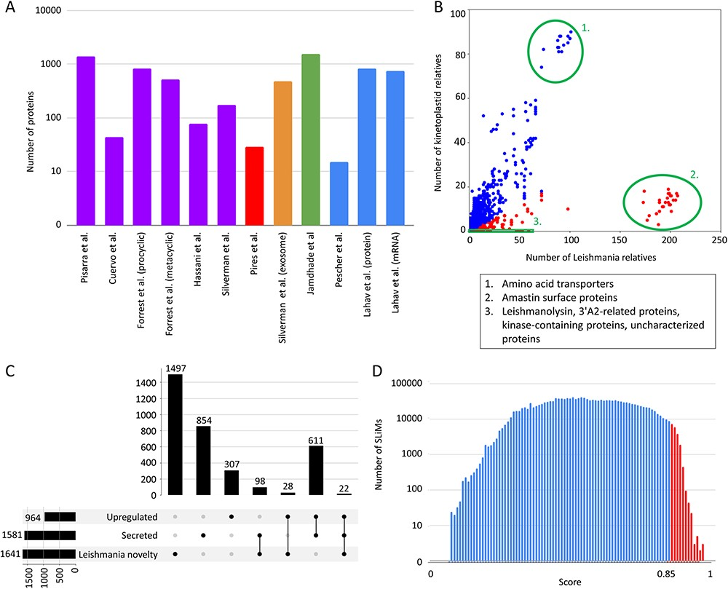
Figure 1. LeishMANIAdb content. All data were calculated on Leishmania infantum. A: Number of proteins in different ...
Notes:
Figure 1. LeishMANIAdb content. All data were calculated on Leishmania infantum. A: Number of proteins in different proteomic datasets (purple: promastigote secretome, red: amastigote secretome, orange: exosome, green: housekeeping genes, blue: higher protein abundance level upon infection). B: Number of kinetoplastid and Leishmania close homologs. Each dot represents a protein (red: at least 80% of close homologs are in Leishmania, blue: other proteins). Green circles represent distinctive groups. C: Overlap between abundant, secreted and ‘Leishmania novelty’ proteins (for more detail see text). D: Distribution of all predicted SLiMs with different scores. Red marks candidate motifs above 0.85 cutoff (for more details see text).
Unless provided in the caption above, the following copyright applies to the content of this slide: © The Author(s) 2024. Published by Oxford University Press.This is an Open Access article distributed under the terms of the Creative Commons Attribution License (https://creativecommons.org/licenses/by/4.0/), which permits unrestricted reuse, distribution, and reproduction in any medium, provided the original work is properly cited.

Slide 2
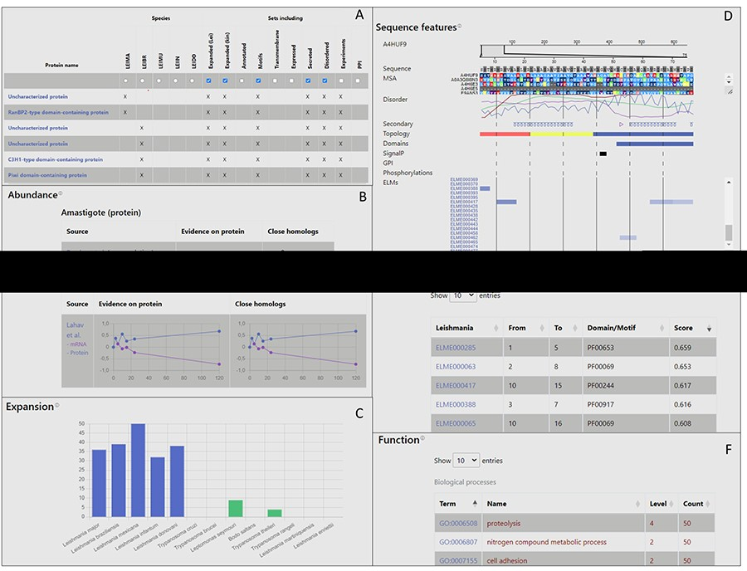
Figure 2. Layout of LeishMANIAdb. A: The search/browse result menu. B: Expression section of the entry page. C: ...
Notes:
Figure 2. Layout of LeishMANIAdb. A: The search/browse result menu. B: Expression section of the entry page. C: Expansion section. D: Sequence features section. E: Putative motif mimicry section. F: Function section.
Unless provided in the caption above, the following copyright applies to the content of this slide: © The Author(s) 2024. Published by Oxford University Press.This is an Open Access article distributed under the terms of the Creative Commons Attribution License (https://creativecommons.org/licenses/by/4.0/), which permits unrestricted reuse, distribution, and reproduction in any medium, provided the original work is properly cited.

Slide 3
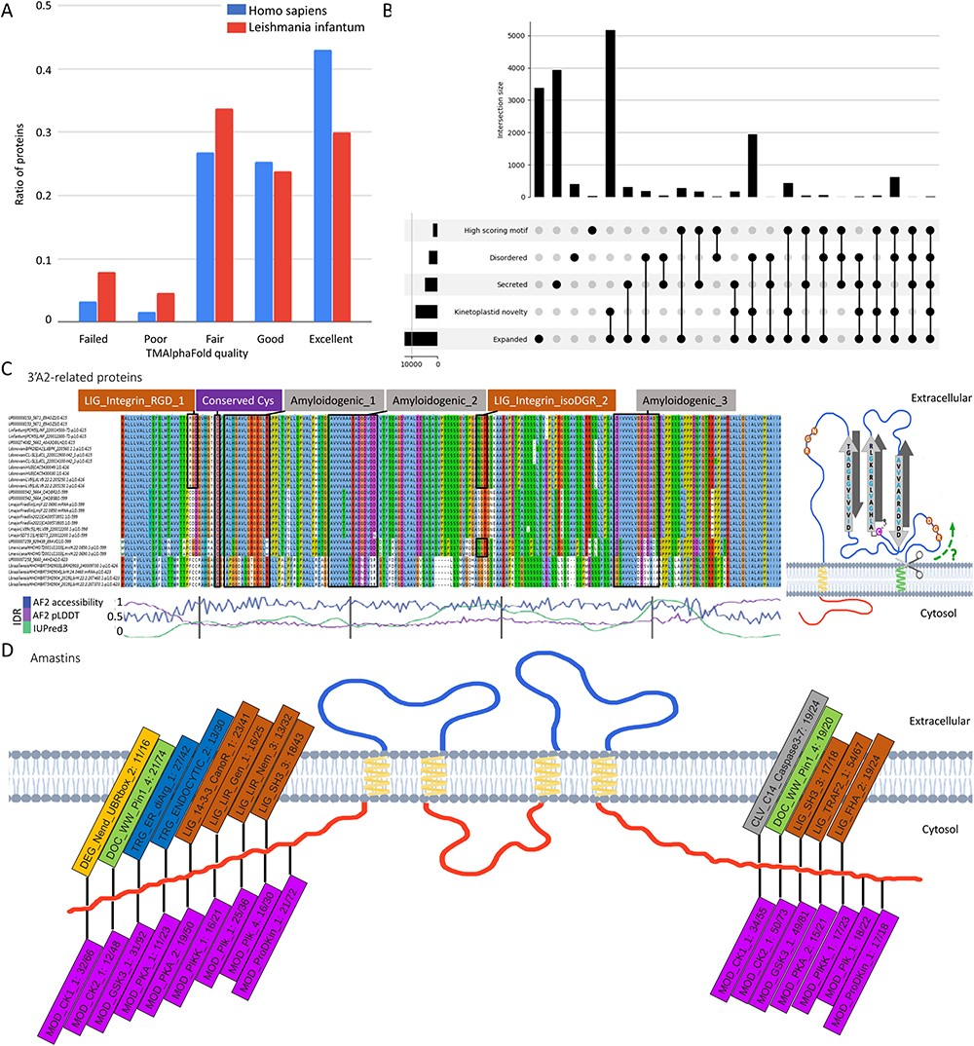
Figure 3. A: Distribution of membrane protein quality levels of AlphaFold structure in Homo sapiens and Leishmania ...
Notes:
Figure 3. A: Distribution of membrane protein quality levels of AlphaFold structure in Homo sapiens and Leishmania infantum. B: Upset diagram of proteins that are (1) secreted, (2) novel kinetoplastid, (3) expanded (or new) in Leishmania, (4) disordered, (5) contain candidate SLiMs. C: left: Multiple Sequence Alignment of 3ʹA2 related proteins (alignment is available under UniProt AC: E9AGZ3). Amyloidogenic regions, conserved cysteine and integrin-binding motifs are highlighted; right: proposed topology of 3ʹA2 related proteins. D: Frequent SLiMs in the cytoplasmic tail regions of amastins (the numbers denote the unique/total occurrences).
Unless provided in the caption above, the following copyright applies to the content of this slide: © The Author(s) 2024. Published by Oxford University Press.This is an Open Access article distributed under the terms of the Creative Commons Attribution License (https://creativecommons.org/licenses/by/4.0/), which permits unrestricted reuse, distribution, and reproduction in any medium, provided the original work is properly cited.

