Slide 1
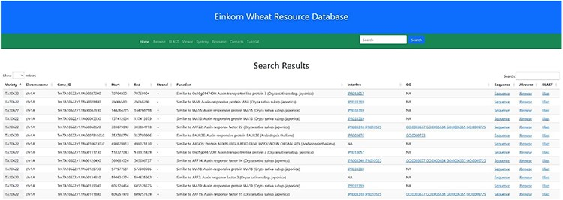
Figure 11. Search result for the search term ‘auxin’. Searching the relational database for any auxin-related genes ...
Notes:
Figure 11. Search result for the search term ‘auxin’. Searching the relational database for any auxin-related genes yielded 338 possible hits. Links to InterPro, Gene Ontology, Gene sequence, JBrowse2 and Blast results are provided in the subsequent columns.
Unless provided in the caption above, the following copyright applies to the content of this slide: © The Author(s) 2023. Published by Oxford University Press.This is an Open Access article distributed under the terms of the Creative Commons Attribution License (https://creativecommons.org/licenses/by/4.0/), which permits unrestricted reuse, distribution, and reproduction in any medium, provided the original work is properly cited.

