Slide 1
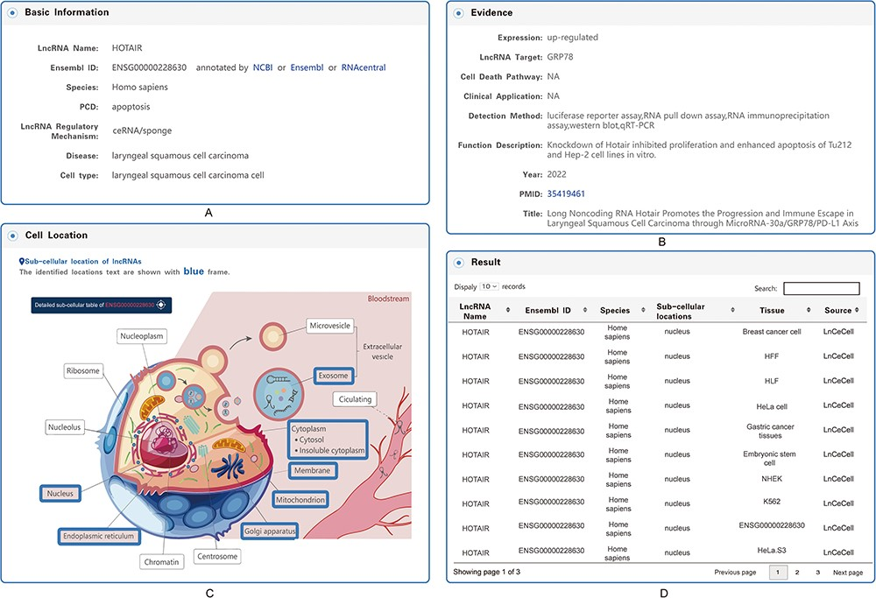
Figure 5. Detailed information for each entry. (A) Basic information on the associations between lncRNA-mediated PCD ...
Notes:
Figure 5. Detailed information for each entry. (A) Basic information on the associations between lncRNA-mediated PCD and diseases. (B) Evidence of the associations between lncRNA-mediated PCD and diseases. (C) Subcellular locations of lncRNAs. (D) Table of the detailed information on subcellular locations.
Unless provided in the caption above, the following copyright applies to the content of this slide: © The Author(s) 2023. Published by Oxford University Press.This is an Open Access article distributed under the terms of the Creative Commons Attribution License (https://creativecommons.org/licenses/by/4.0/), which permits unrestricted reuse, distribution, and reproduction in any medium, provided the original work is properly cited.

