Slide 1
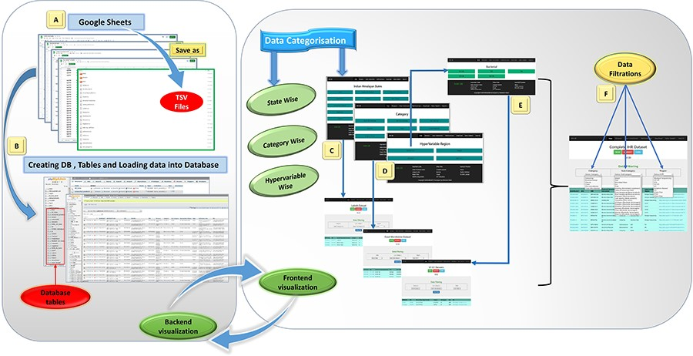
Figure 1. Database preparation, visualization, and workflow from back-end to front-end development of the IHM-DB. (A) ...
Notes:
Figure 1. Database preparation, visualization, and workflow from back-end to front-end development of the IHM-DB. (A) Collection of the dataset from publicly available databases. The dataset was manually collected from publicly available databases and stored in Google sheets (tsv files). (B) Creation of database tables in MySQL and loading of collected tsv files. (C–E) Web page visualization of metagenomic data categorized into state-wise, category-wise, and hypervariable-wise classifications. (F) Completion of the IHR dataset on a single page. The users can access the complete metagenome data as well as can use the option of filtration for desirable information.
Unless provided in the caption above, the following copyright applies to the content of this slide: © The Author(s) 2023. Published by Oxford University Press.This is an Open Access article distributed under the terms of the Creative Commons Attribution License (https://creativecommons.org/licenses/by/4.0/), which permits unrestricted reuse, distribution, and reproduction in any medium, provided the original work is properly cited.

Slide 2
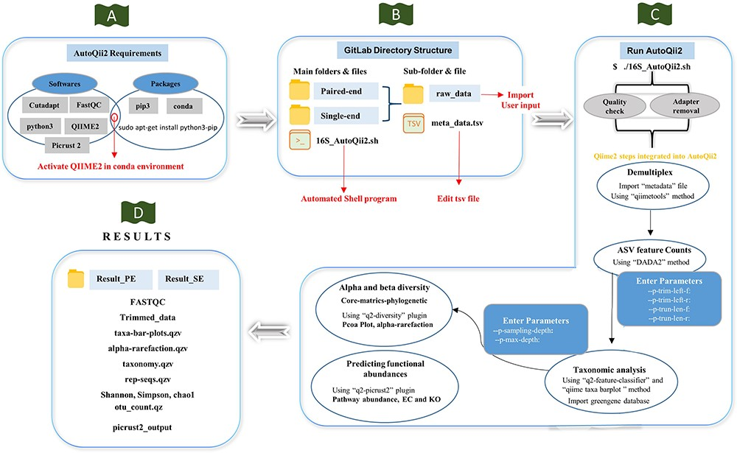
Figure 2. Workflow of AutoQii2 pipeline. (A) Third-party software requirement for AutoQii2. The users are required to ...
Notes:
Figure 2. Workflow of AutoQii2 pipeline. (A) Third-party software requirement for AutoQii2. The users are required to install FastQC, cutadapt and QIIME 2 and activate QIIME 2 under conda environment. (B) Open-source code available in GitLab for paired-end (PE) and single-end (SE) analysis. The users are required to edit metadata.tsv and subdirectory ‘raw_data’ available inside the PE and SE folder. ‘16SAutoQii2.sh’ is an automated shell script program. (C) Analysis steps of autoqii2. (D) Results of AutoQii2 Pipeline.
Unless provided in the caption above, the following copyright applies to the content of this slide: © The Author(s) 2023. Published by Oxford University Press.This is an Open Access article distributed under the terms of the Creative Commons Attribution License (https://creativecommons.org/licenses/by/4.0/), which permits unrestricted reuse, distribution, and reproduction in any medium, provided the original work is properly cited.

Slide 3
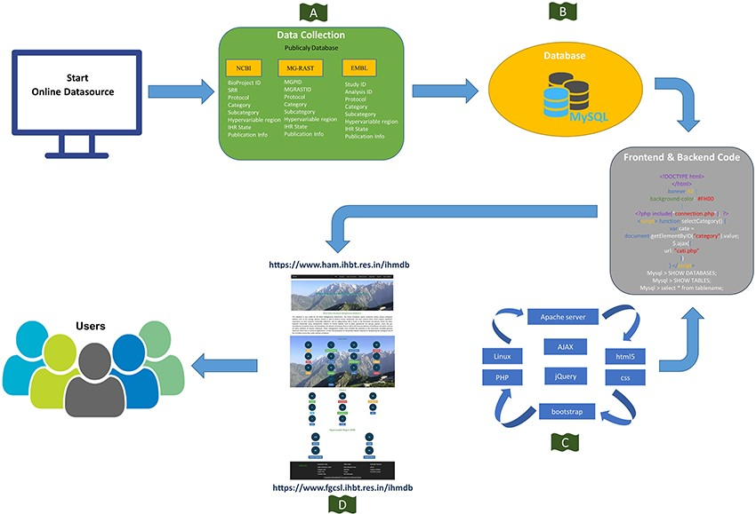
Figure 3. Schematic representation of the IHM-DB. (A) Data collection from publicly available database (NCBI, MG-RAST ...
Notes:
Figure 3. Schematic representation of the IHM-DB. (A) Data collection from publicly available database (NCBI, MG-RAST and EMBL). (B) Storage of all the collected datasets information’s into MySQL database. (C) Languages used for developing the IHM-DB. (D) User-friendly interface of the IHM-DB.
Unless provided in the caption above, the following copyright applies to the content of this slide: © The Author(s) 2023. Published by Oxford University Press.This is an Open Access article distributed under the terms of the Creative Commons Attribution License (https://creativecommons.org/licenses/by/4.0/), which permits unrestricted reuse, distribution, and reproduction in any medium, provided the original work is properly cited.

Slide 4
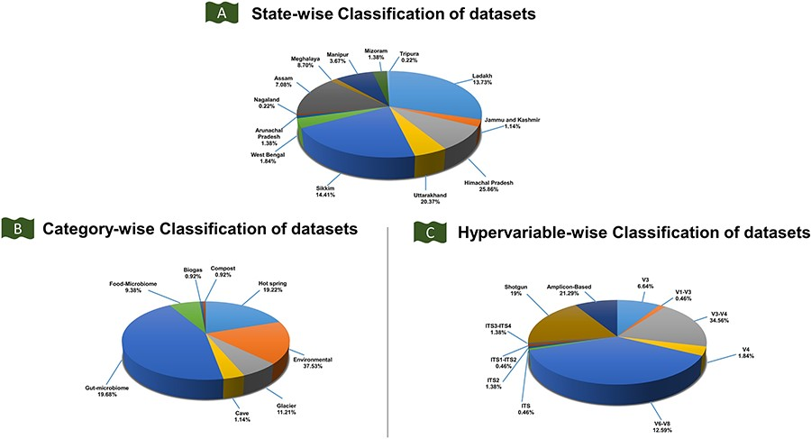
Figure 4. Classification of the IHM-DB. (A) State-wise classification of datasets defines the percentage share of ...
Notes:
Figure 4. Classification of the IHM-DB. (A) State-wise classification of datasets defines the percentage share of datasets for 13 IHR states. (B) The percentage share for category-wise datasets. The datasets are divided into six categories: food microbiome, gut microbiome, hot spring, cave, environmental, and glacier. (C) The percentage share for hypervariable-wise data. The hypervariable dataset is classified into 11 categories based on shotgun and amplicon-based sequences.
Unless provided in the caption above, the following copyright applies to the content of this slide: © The Author(s) 2023. Published by Oxford University Press.This is an Open Access article distributed under the terms of the Creative Commons Attribution License (https://creativecommons.org/licenses/by/4.0/), which permits unrestricted reuse, distribution, and reproduction in any medium, provided the original work is properly cited.

Slide 5
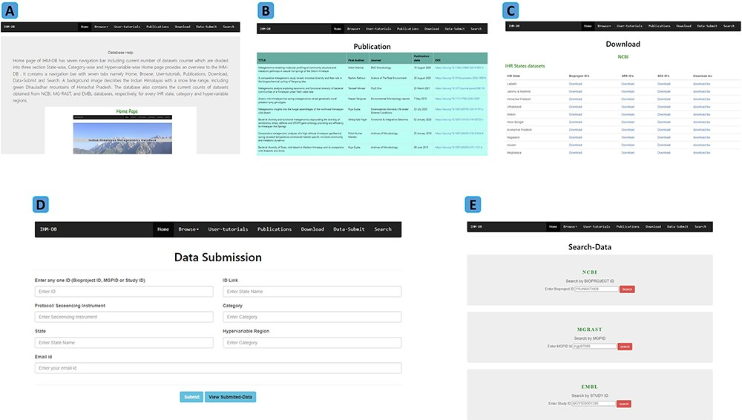
Figure 5. Explanation of navigation tabs in the IHM-DB. (A) Tutorial page with example usage of the IHM-DB. (B) List of ...
Notes:
Figure 5. Explanation of navigation tabs in the IHM-DB. (A) Tutorial page with example usage of the IHM-DB. (B) List of metagenomic publications from the IHR. (C) Download page for NCBI, EMBL, and, MG-RAST databases datasets of the IHR data. (D) Data-submit page. The users can submit their data through the Data-Submit page by submitting inputs like NCBI BioProject ID, MG-RAST MGPID, EMBL study ID), ID Link, Protocol/ Sequencing Instrument, Category, State, Hypervariable region, and user email ID. (E) Search page. The users can directly search the dataset by entering BioProject ID, MGPID, and Study ID of NCBI, MG-RAST, and EMBL databases, respectively.
Unless provided in the caption above, the following copyright applies to the content of this slide: © The Author(s) 2023. Published by Oxford University Press.This is an Open Access article distributed under the terms of the Creative Commons Attribution License (https://creativecommons.org/licenses/by/4.0/), which permits unrestricted reuse, distribution, and reproduction in any medium, provided the original work is properly cited.

Slide 6
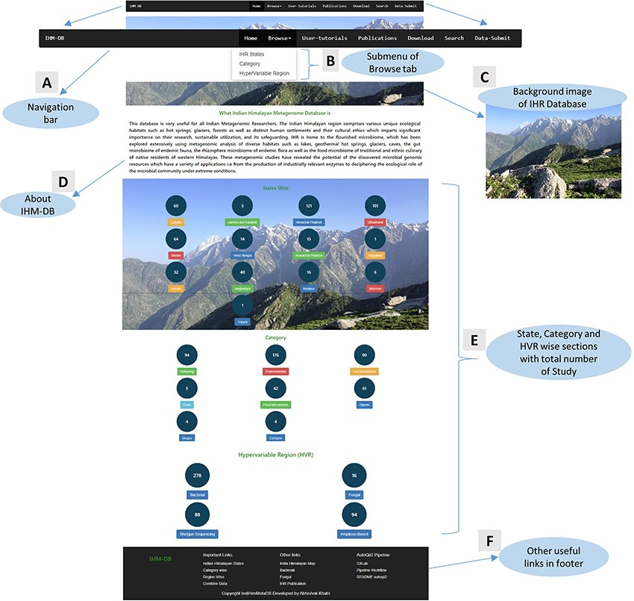
Figure 6. Home page details of the IHM-DB. (A) The home page view of the IHM-DB navigational bar with seven different ...
Notes:
Figure 6. Home page details of the IHM-DB. (A) The home page view of the IHM-DB navigational bar with seven different tabs. (B). Browse tab. It consists of three subtab categories. (C) Background image which describes the Indian Himalayas with a snow line range, including the green Dhauladhar Mountain of Himachal Pradesh. (D) Short description about the IHM-DB. (E) Total number of studies from NCBI, EMBL, and MG-RAST with state-, category- and hypervariable-wise data. (F) Database footer includes other useful links for quick access.
Unless provided in the caption above, the following copyright applies to the content of this slide: © The Author(s) 2023. Published by Oxford University Press.This is an Open Access article distributed under the terms of the Creative Commons Attribution License (https://creativecommons.org/licenses/by/4.0/), which permits unrestricted reuse, distribution, and reproduction in any medium, provided the original work is properly cited.

