Slide 1
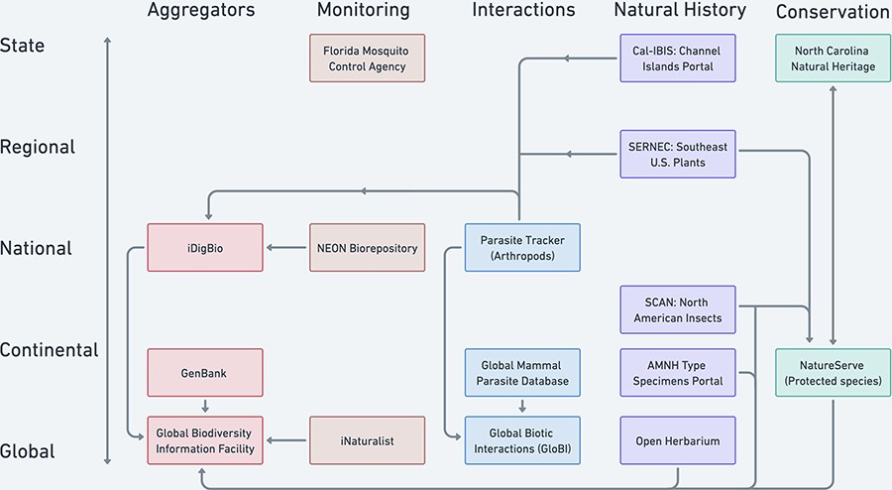
Figure 5. Selected examples of North American and global biodiversity data pooling projects illustrate the current ...
Notes:
Figure 5. Selected examples of North American and global biodiversity data pooling projects illustrate the current partially coordinated flow of biodiversity data (uni- or bi-directional arrows). Projects are distinguished by the geographic scale (y-axis) and type of domain used to characterize their scope (colors by column on the x-axis). The aggregator column represents some important biodiversity data pooling projects whose scopes cut across the other domain categories.
Unless provided in the caption above, the following copyright applies to the content of this slide: © The Author(s) 2023. Published by Oxford University Press.This is an Open Access article distributed under the terms of the Creative Commons Attribution License (https://creativecommons.org/licenses/by/4.0/), which permits unrestricted reuse, distribution, and reproduction in any medium, provided the original work is properly cited.

