Slide 1
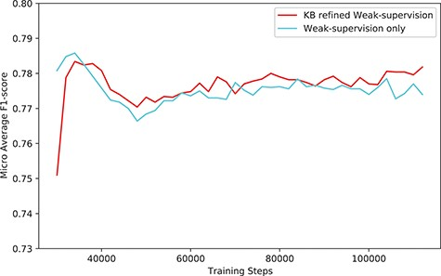
Figure 6. The performance (F1-score) of our system (KB-refined weak supervision) and the model trained using simple ...
Notes:
Figure 6. The performance (F1-score) of our system (KB-refined weak supervision) and the model trained using simple weak supervision (weak supervision without KB refine).
Unless provided in the caption above, the following copyright applies to the content of this slide: © The Author(s) 2023. Published by Oxford University Press.This is an Open Access article distributed under the terms of the Creative Commons Attribution License (https://creativecommons.org/licenses/by/4.0/), which permits unrestricted reuse, distribution, and reproduction in any medium, provided the original work is properly cited.

