Slide 1
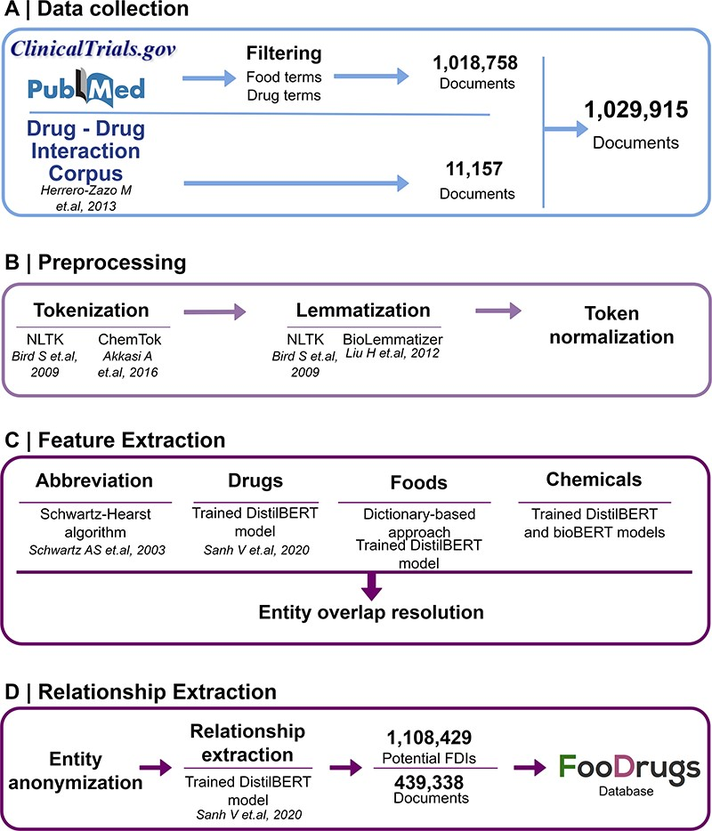
Figure 1. General overview of the NLP approach. (A) Data collection was performed by collecting documents containing at ...
Notes:
Figure 1. General overview of the NLP approach. (A) Data collection was performed by collecting documents containing at least one food and drug term in their titles and abstracts, as well as the whole DDI corpus. (B) Data preprocessing step is applied to the documents for better integration in the pipeline. (C) In the feature extraction step, different entities are recognized in the text via different methods, and entity overlap resolution is done when necessary. (D) Finally, for relationship extraction, entities are anonymized to work with the relationship extraction model used, and the resulting FDIs and documents are stored in the FooDrugs database.
Unless provided in the caption above, the following copyright applies to the content of this slide: © The Author(s) 2023. Published by Oxford University Press.This is an Open Access article distributed under the terms of the Creative Commons Attribution License (https://creativecommons.org/licenses/by/4.0/), which permits unrestricted reuse, distribution, and reproduction in any medium, provided the original work is properly cited.

Slide 2
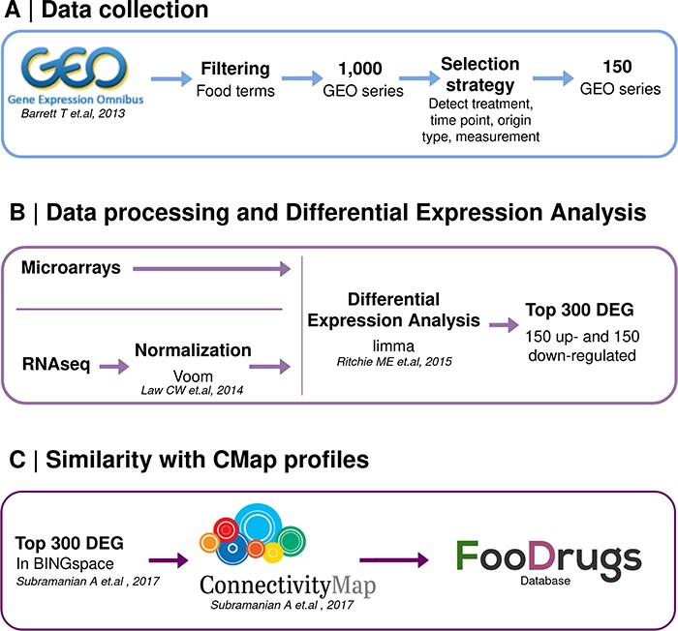
Figure 2. Schematic representation of the overall transcriptomic approach. (A) Data collection consists of the search ...
Notes:
Figure 2. Schematic representation of the overall transcriptomic approach. (A) Data collection consists of the search of food transcriptomic studies with food keywords. (B) Data processing and differential expression analysis are performed with limma to get 150 up- and down-regulated genes in food condition vs control. (C) Genes present in BING space sent to CMap to compute similarity scores with drug transcriptomic profiles.
Unless provided in the caption above, the following copyright applies to the content of this slide: © The Author(s) 2023. Published by Oxford University Press.This is an Open Access article distributed under the terms of the Creative Commons Attribution License (https://creativecommons.org/licenses/by/4.0/), which permits unrestricted reuse, distribution, and reproduction in any medium, provided the original work is properly cited.

Slide 3
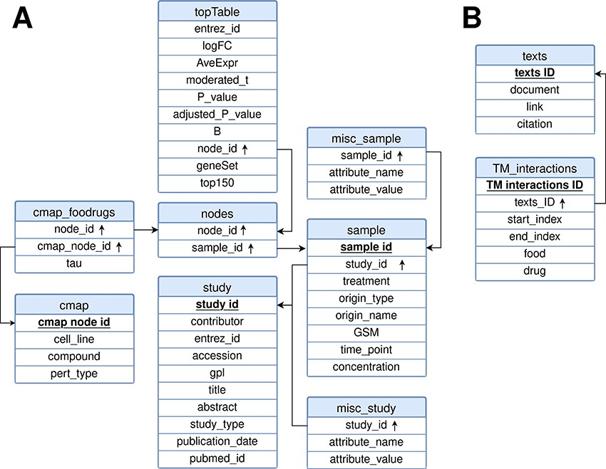
Figure 3. Relational model for the FooDrugs database. Primary keys for each table are marked in bold and underlined. ...
Notes:
Figure 3. Relational model for the FooDrugs database. Primary keys for each table are marked in bold and underlined. Foreign keys are marked by an arrow pointing upwards. The database is formed by two independent components: (A) a molecular component, built from GEO studies involving food compounds or bioactives, and (B) a text mining component, built using NLP.
Unless provided in the caption above, the following copyright applies to the content of this slide: © The Author(s) 2023. Published by Oxford University Press.This is an Open Access article distributed under the terms of the Creative Commons Attribution License (https://creativecommons.org/licenses/by/4.0/), which permits unrestricted reuse, distribution, and reproduction in any medium, provided the original work is properly cited.

Slide 4
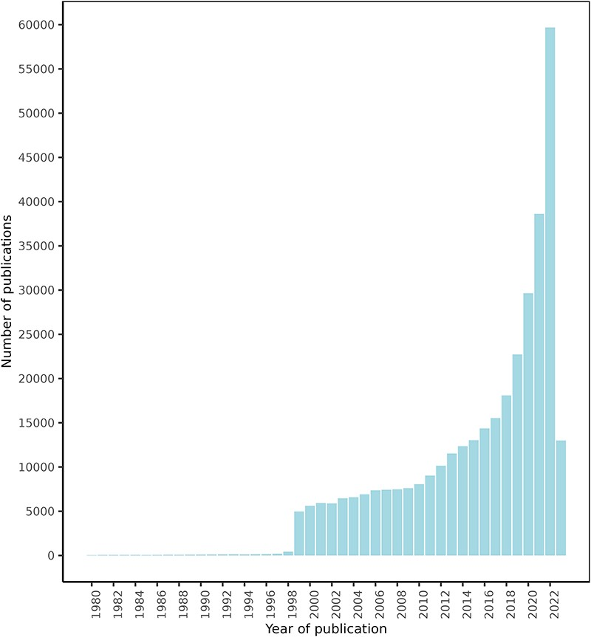
Figure 4. FooDrugs PubMed articles distribution by publication date. Articles with publication dates between 1980 and ...
Notes:
Figure 4. FooDrugs PubMed articles distribution by publication date. Articles with publication dates between 1980 and 2023 are shown. 779 articles published before 1980 are excluded from the figure. Search date was 28 July 2023.
Unless provided in the caption above, the following copyright applies to the content of this slide: © The Author(s) 2023. Published by Oxford University Press.This is an Open Access article distributed under the terms of the Creative Commons Attribution License (https://creativecommons.org/licenses/by/4.0/), which permits unrestricted reuse, distribution, and reproduction in any medium, provided the original work is properly cited.

Slide 5
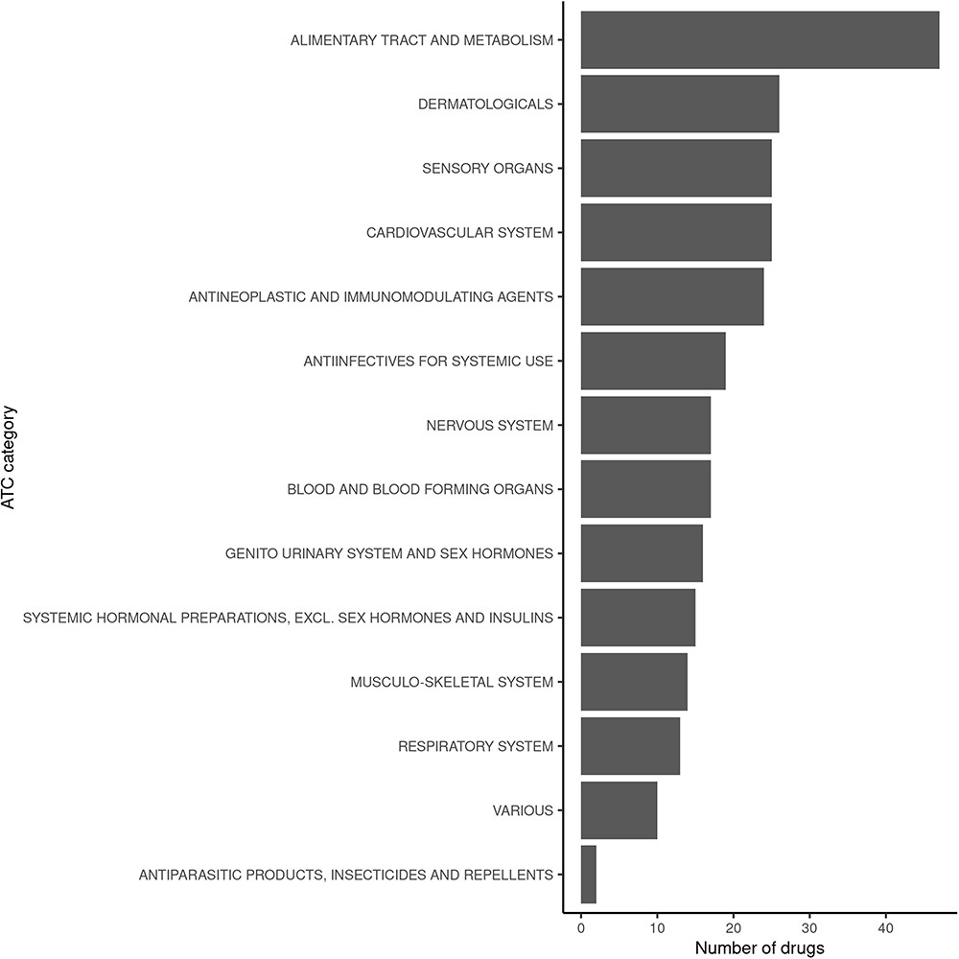
Figure 5. Classification of drugs found to interact with vitamin D in FooDrugs database, according to ATC ...
Notes:
Figure 5. Classification of drugs found to interact with vitamin D in FooDrugs database, according to ATC classification. Only ATC Level 1 categories were considered for this comparison.
Unless provided in the caption above, the following copyright applies to the content of this slide: © The Author(s) 2023. Published by Oxford University Press.This is an Open Access article distributed under the terms of the Creative Commons Attribution License (https://creativecommons.org/licenses/by/4.0/), which permits unrestricted reuse, distribution, and reproduction in any medium, provided the original work is properly cited.

