Slide 1
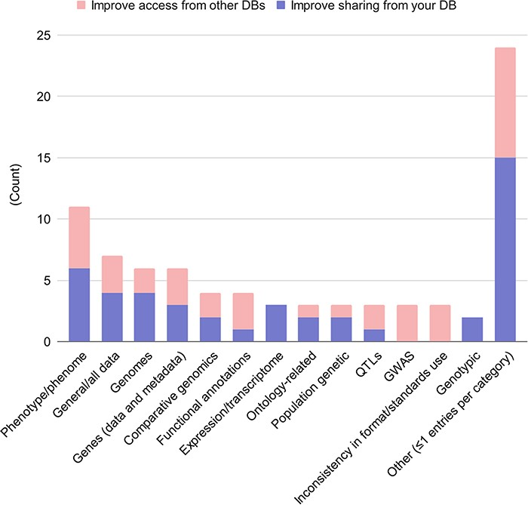
Figure 5. Desired data and metadata types shared among databases. Free-form answers from the questions 9.5 and 10.7 ...
Notes:
Figure 5. Desired data and metadata types shared among databases. Free-form answers from the questions 9.5 and 10.7 (what data and metadata would you like to share) were aggregated, with responses in blue; and free-form answers from questions 9.6 and 10.8 (what data and metadata would you like to access from other databases) were aggregated, with responses in red.
Unless provided in the caption above, the following copyright applies to the content of this slide: Published by Oxford University Press 2023. This work is written by (a) US Government employee(s) and is in the public domain in the US.This work is written by (a) US Government employee(s) and is in the public domain in the US.

