Slide 1
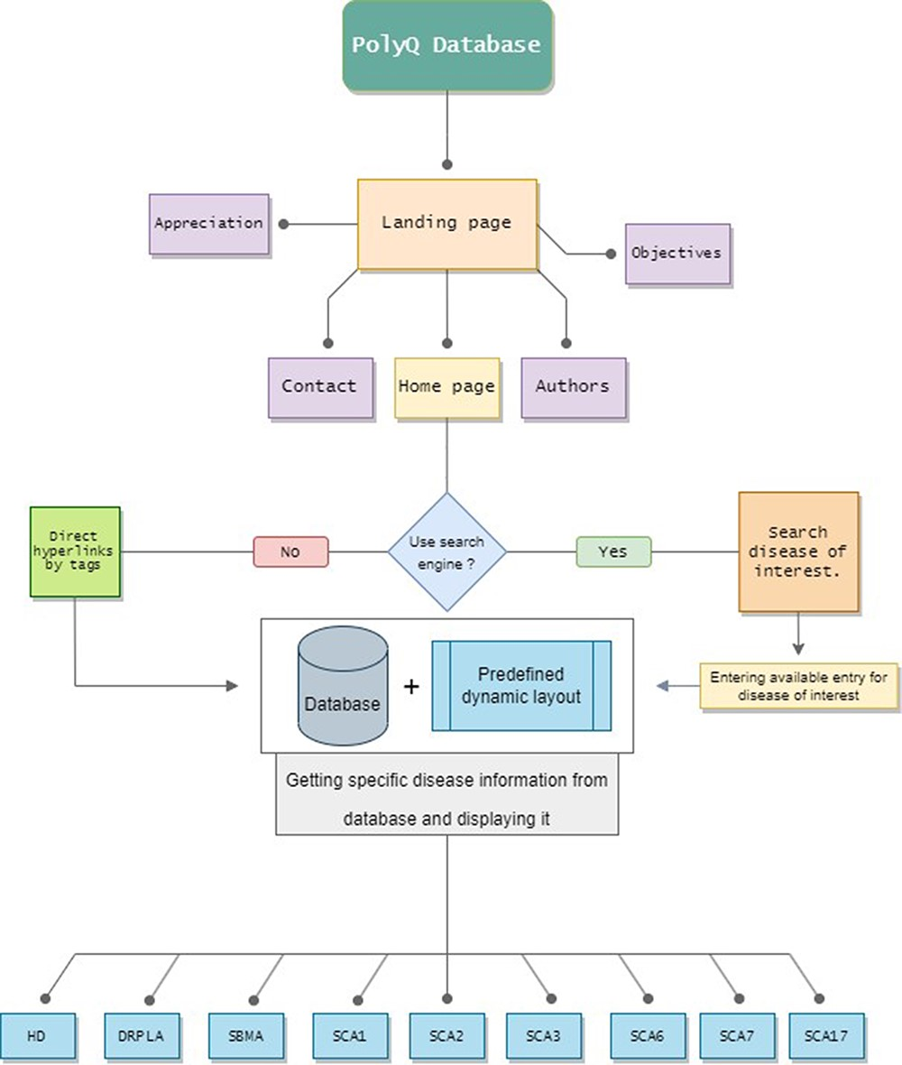
Figure 1. The PolyQ Database structure, depicting all the available pages, routes and disease options. Home page has ...
Notes:
Figure 1. The PolyQ Database structure, depicting all the available pages, routes and disease options. Home page has two different options to access any Disease page.
Unless provided in the caption above, the following copyright applies to the content of this slide: © The Author(s) 2023. Published by Oxford University Press.This is an Open Access article distributed under the terms of the Creative Commons Attribution License (https://creativecommons.org/licenses/by/4.0/), which permits unrestricted reuse, distribution, and reproduction in any medium, provided the original work is properly cited.

Slide 2
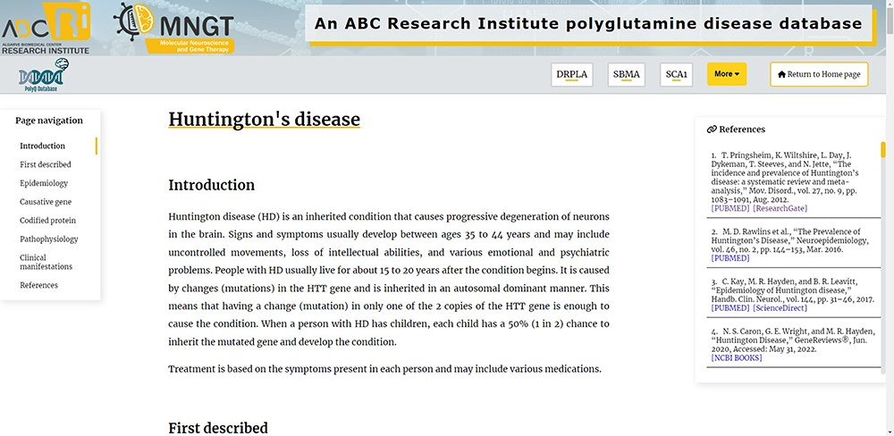
Figure 2. Top of the Huntington’s Disease page, presenting all the additional features of the Diseases pages mentioned ...
Notes:
Figure 2. Top of the Huntington’s Disease page, presenting all the additional features of the Diseases pages mentioned in the text.
Unless provided in the caption above, the following copyright applies to the content of this slide: © The Author(s) 2023. Published by Oxford University Press.This is an Open Access article distributed under the terms of the Creative Commons Attribution License (https://creativecommons.org/licenses/by/4.0/), which permits unrestricted reuse, distribution, and reproduction in any medium, provided the original work is properly cited.

