Slide 1
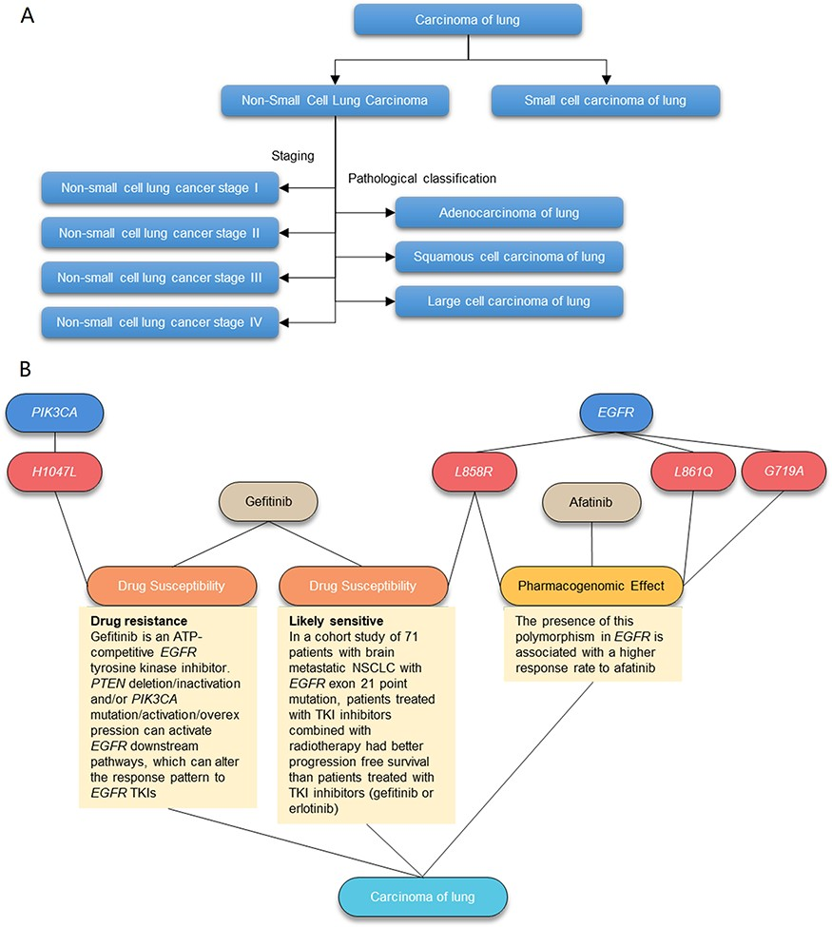
Figure 2. Illustration of the AIMedGraph relation graph. (A) Example of the disease classification tree. (B) Example of ...
Notes:
Figure 2. Illustration of the AIMedGraph relation graph. (A) Example of the disease classification tree. (B) Example of the relation graph between genes, variants, drugs and diseases.
Unless provided in the caption above, the following copyright applies to the content of this slide: © The Author(s) 2023. Published by Oxford University Press.This is an Open Access article distributed under the terms of the Creative Commons Attribution License (https://creativecommons.org/licenses/by/4.0/), which permits unrestricted reuse, distribution, and reproduction in any medium, provided the original work is properly cited.

