Slide 1
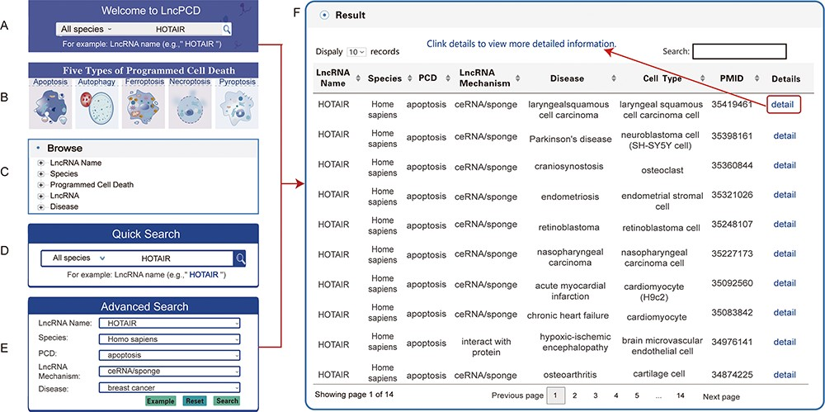
Figure 4. Search methods and results in the LncPCD database. There are five methods to obtain related information. (A) ...
Notes:
Figure 4. Search methods and results in the LncPCD database. There are five methods to obtain related information. (A) Quick search function on the Home page. (B) Image links to the five types of PCD on the home page. (C) Tree view function on the left side of the Browse page. (D) Quick Search function on the Search page. (E) Advanced Search function on the Search page. Through each of the above methods, a result table is obtained. (F) LncPCD results are organized in a data table, with a single association record on each line.
Unless provided in the caption above, the following copyright applies to the content of this slide: © The Author(s) 2023. Published by Oxford University Press.This is an Open Access article distributed under the terms of the Creative Commons Attribution License (https://creativecommons.org/licenses/by/4.0/), which permits unrestricted reuse, distribution, and reproduction in any medium, provided the original work is properly cited.

