Slide 1
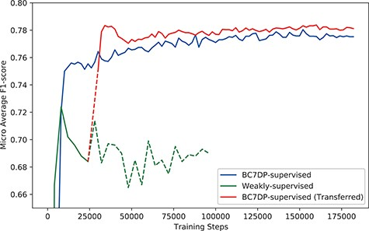
Figure 4. The performance (F1-score) of models by the total training steps. The solid line (BC7DP-supervised) ...
Notes:
Figure 4. The performance (F1-score) of models by the total training steps. The solid line (BC7DP-supervised) represents the performance of a model trained using the original dataset. The line starting with dotted line and soon changed into solid line, denoted as BC7DP-supervised (Transferred), represents the performance of our system. The line strarting with solid line but soon changed into dotted line, denoted as Weakly-supervised, represents a model trained only on weakly supervised datasets (without the third phase of our system). Note that the solid part of BC7DP-supervised (Transferred) linestarts at the 28 000th step of the Weakly-supervised line as it is transferred from the 28 000th step of the weakly supervised only model. For the BC7DP-supervised and BC7DP-supervised (Transferred), F1-scores are averaged across five independent runs.
Unless provided in the caption above, the following copyright applies to the content of this slide: © The Author(s) 2023. Published by Oxford University Press.This is an Open Access article distributed under the terms of the Creative Commons Attribution License (https://creativecommons.org/licenses/by/4.0/), which permits unrestricted reuse, distribution, and reproduction in any medium, provided the original work is properly cited.

