Slide 1
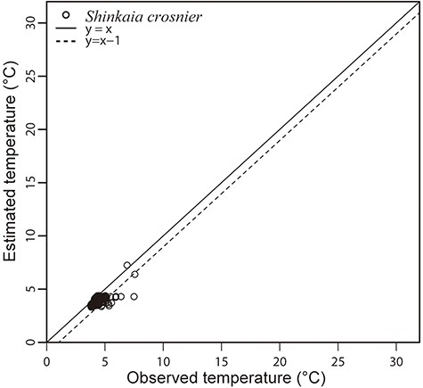
Figure 2. Observed in situ temperatures by CTD of S. crosnieri habitat and estimated temperatures by BISMaL based on ...
Notes:
Figure 2. Observed in situ temperatures by CTD of S. crosnieri habitat and estimated temperatures by BISMaL based on FORA. When the observed in situ temperature corresponds to the estimated temperature, data are plotted along the solid line (y = x).
Unless provided in the caption above, the following copyright applies to the content of this slide: © The Author(s) 2023. Published by Oxford University Press.This is an Open Access article distributed under the terms of the Creative Commons Attribution License (https://creativecommons.org/licenses/by/4.0/), which permits unrestricted reuse, distribution, and reproduction in any medium, provided the original work is properly cited.

