Slide 1
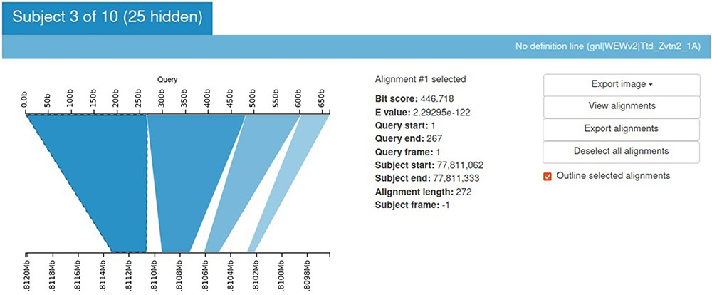
Figure 8. Kablammo display for the BLAST results of a sample query sequence. Various alignment statistics are being ...
Notes:
Figure 8. Kablammo display for the BLAST results of a sample query sequence. Various alignment statistics are being shown along with the option to view/download images and alignments. Please see the tutorial on the einkorn resource database webpage on how to generate this output (https://avena.pw.usda.gov/genomes/mono/pan_help.php).
Unless provided in the caption above, the following copyright applies to the content of this slide: © The Author(s) 2023. Published by Oxford University Press.This is an Open Access article distributed under the terms of the Creative Commons Attribution License (https://creativecommons.org/licenses/by/4.0/), which permits unrestricted reuse, distribution, and reproduction in any medium, provided the original work is properly cited.

