Slide 1
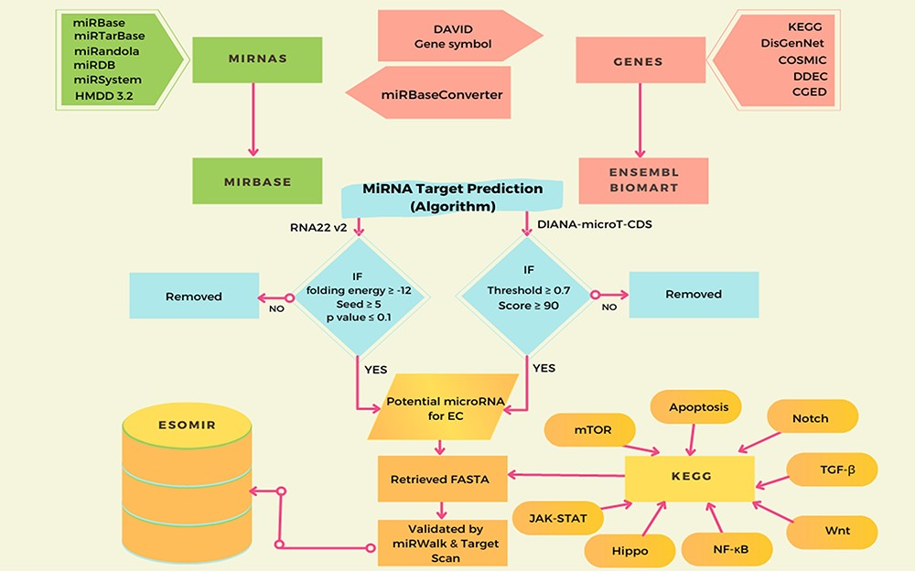
Figure 1. This diagram illustrates the ESOMIR modules, representing data analysis, prediction and mining procedures. ...
Notes:
Figure 1. This diagram illustrates the ESOMIR modules, representing data analysis, prediction and mining procedures. Each stage in the process is clearly defined in this schematic, outlining the steps taken to reach the desired outcome.
Unless provided in the caption above, the following copyright applies to the content of this slide: © The Author(s) 2023. Published by Oxford University Press.This is an Open Access article distributed under the terms of the Creative Commons Attribution License (https://creativecommons.org/licenses/by/4.0/), which permits unrestricted reuse, distribution, and reproduction in any medium, provided the original work is properly cited.

Slide 2
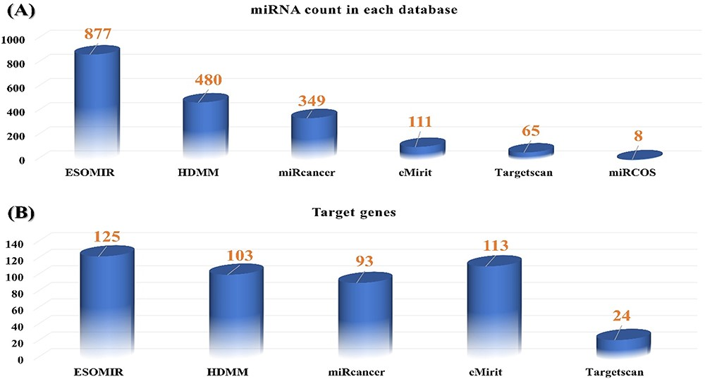
Figure 2. (A) Comparison of all available miRNA targets associated with EC in ESOMIR and other available databases. The ...
Notes:
Figure 2. (A) Comparison of all available miRNA targets associated with EC in ESOMIR and other available databases. The figure shows that ESOMIR has the highest number of miRNAs included in contrast to the other available databases. (B) Comparison of all available mRNAs associated with EC in ESOMIR and other available databases.
Unless provided in the caption above, the following copyright applies to the content of this slide: © The Author(s) 2023. Published by Oxford University Press.This is an Open Access article distributed under the terms of the Creative Commons Attribution License (https://creativecommons.org/licenses/by/4.0/), which permits unrestricted reuse, distribution, and reproduction in any medium, provided the original work is properly cited.

Slide 3
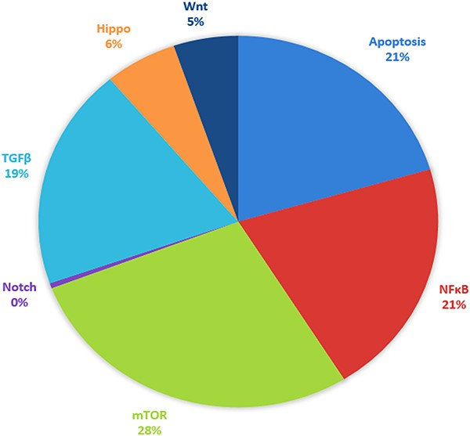
Figure 3. Signaling pathway targeted by selected putative miRNA associated with EC. The respective pathways along with ...
Notes:
Figure 3. Signaling pathway targeted by selected putative miRNA associated with EC. The respective pathways along with their percentages are given and represented by different colors.
Unless provided in the caption above, the following copyright applies to the content of this slide: © The Author(s) 2023. Published by Oxford University Press.This is an Open Access article distributed under the terms of the Creative Commons Attribution License (https://creativecommons.org/licenses/by/4.0/), which permits unrestricted reuse, distribution, and reproduction in any medium, provided the original work is properly cited.

Slide 4
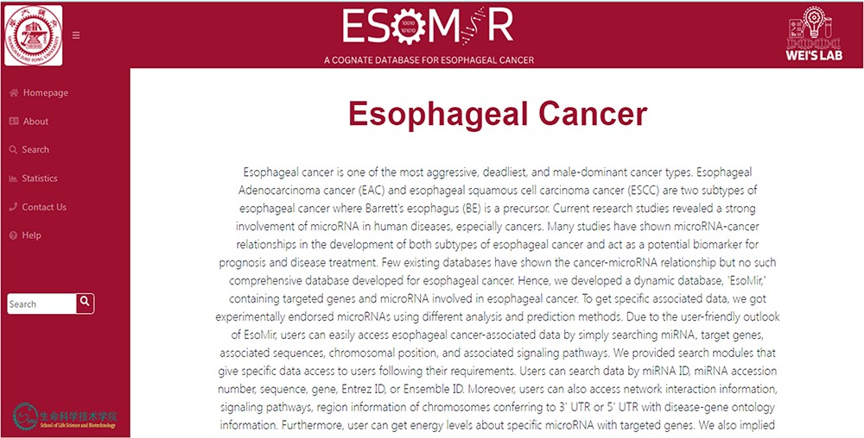
Figure 4. ESOMIR Homepage: a comprehensive miRNA database for EC. The home page shows the description of the database ...
Notes:
Figure 4. ESOMIR Homepage: a comprehensive miRNA database for EC. The home page shows the description of the database with different tabs that are included in the database. The Fuzzy Search Functionality implemented in ESOMIR is also given.
Unless provided in the caption above, the following copyright applies to the content of this slide: © The Author(s) 2023. Published by Oxford University Press.This is an Open Access article distributed under the terms of the Creative Commons Attribution License (https://creativecommons.org/licenses/by/4.0/), which permits unrestricted reuse, distribution, and reproduction in any medium, provided the original work is properly cited.

Slide 5
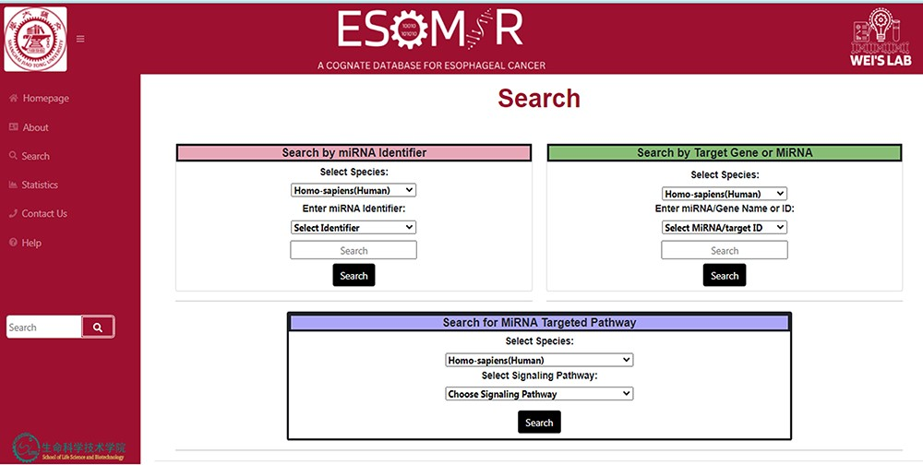
Figure 5. Demonstrative depiction of the Search page to access data using different modules. In the above figure from ...
Notes:
Figure 5. Demonstrative depiction of the Search page to access data using different modules. In the above figure from the database, it can be seen that the information can be retrieved through search by miRNA identifier search, search by target gene or miRNA or search for miRNA targeted pathway.
Unless provided in the caption above, the following copyright applies to the content of this slide: © The Author(s) 2023. Published by Oxford University Press.This is an Open Access article distributed under the terms of the Creative Commons Attribution License (https://creativecommons.org/licenses/by/4.0/), which permits unrestricted reuse, distribution, and reproduction in any medium, provided the original work is properly cited.

Slide 6
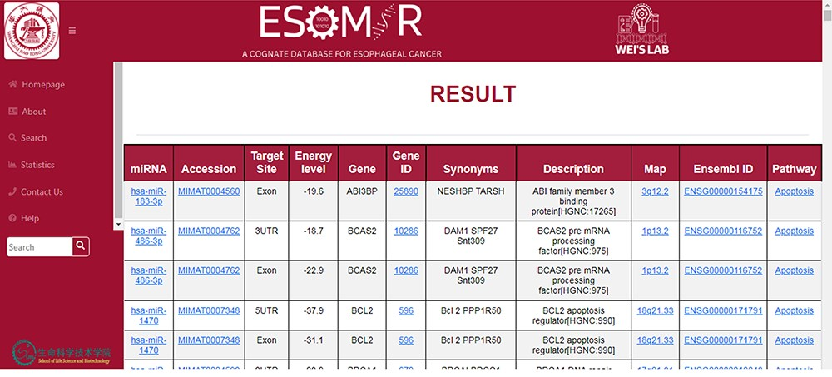
Figure 6. An illustration of the ESOMIR result page presented in a tabular format. The results show the miRNA, ...
Notes:
Figure 6. An illustration of the ESOMIR result page presented in a tabular format. The results show the miRNA, accession ID, target site, EL and other information including the gene name and pathways.
Unless provided in the caption above, the following copyright applies to the content of this slide: © The Author(s) 2023. Published by Oxford University Press.This is an Open Access article distributed under the terms of the Creative Commons Attribution License (https://creativecommons.org/licenses/by/4.0/), which permits unrestricted reuse, distribution, and reproduction in any medium, provided the original work is properly cited.

Slide 7
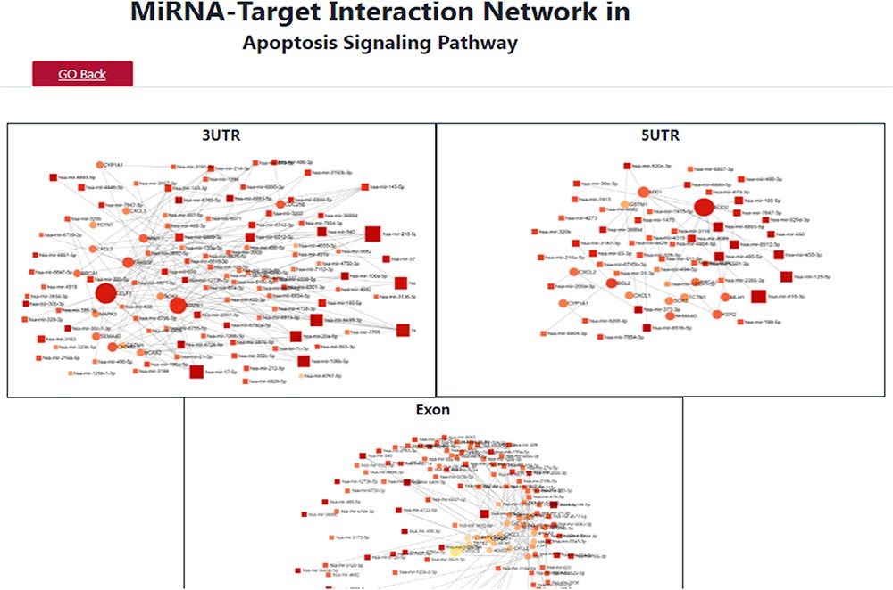
Figure 7. A depiction of the search results for the apoptosis signaling pathway, showcasing the target miRNA–mRNA ...
Notes:
Figure 7. A depiction of the search results for the apoptosis signaling pathway, showcasing the target miRNA–mRNA network.
Unless provided in the caption above, the following copyright applies to the content of this slide: © The Author(s) 2023. Published by Oxford University Press.This is an Open Access article distributed under the terms of the Creative Commons Attribution License (https://creativecommons.org/licenses/by/4.0/), which permits unrestricted reuse, distribution, and reproduction in any medium, provided the original work is properly cited.

Slide 8
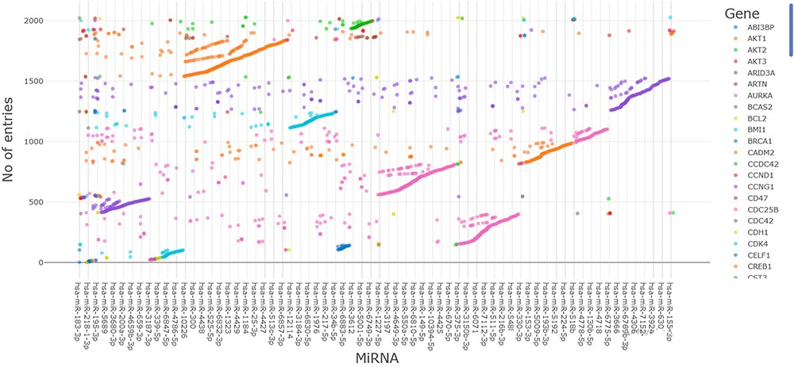
Figure 8. An illustration of >2000 mRNA–miRNA interactions that are exclusively linked to EC in the ESOMIR database.
Notes:
Figure 8. An illustration of >2000 mRNA–miRNA interactions that are exclusively linked to EC in the ESOMIR database.
Unless provided in the caption above, the following copyright applies to the content of this slide: © The Author(s) 2023. Published by Oxford University Press.This is an Open Access article distributed under the terms of the Creative Commons Attribution License (https://creativecommons.org/licenses/by/4.0/), which permits unrestricted reuse, distribution, and reproduction in any medium, provided the original work is properly cited.

Slide 9
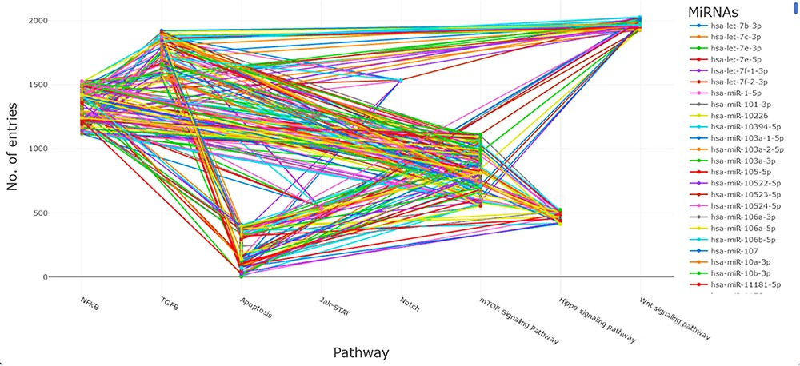
Figure 9. A depiction of the miRNA–target interactions, along with their corresponding signaling pathways.
Notes:
Figure 9. A depiction of the miRNA–target interactions, along with their corresponding signaling pathways.
Unless provided in the caption above, the following copyright applies to the content of this slide: © The Author(s) 2023. Published by Oxford University Press.This is an Open Access article distributed under the terms of the Creative Commons Attribution License (https://creativecommons.org/licenses/by/4.0/), which permits unrestricted reuse, distribution, and reproduction in any medium, provided the original work is properly cited.

Slide 10
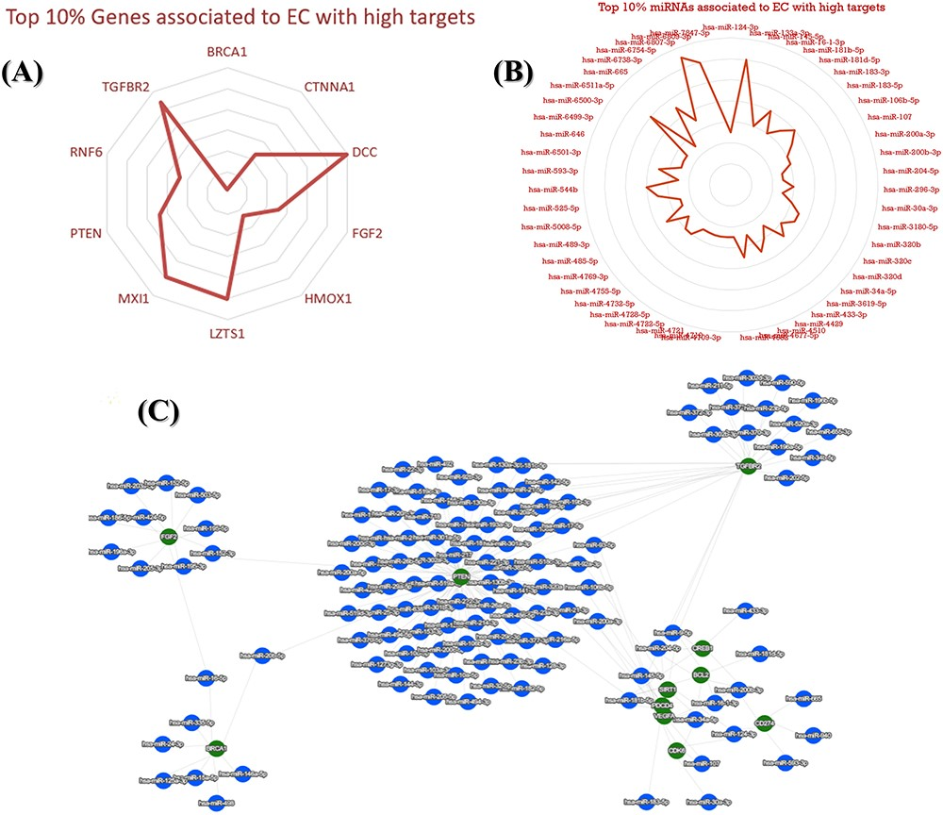
Figure 10. An illustration of top key mRNA and miRNA targets associated with EC. (A) The top 10% identified genes ...
Notes:
Figure 10. An illustration of top key mRNA and miRNA targets associated with EC. (A) The top 10% identified genes associated with EC. (B) The top 10% identified miRNAs associated with EC. (C) A network that visualizes the top connections and associations between mRNA and miRNAs, highlighting the most significant interactions among them.
Unless provided in the caption above, the following copyright applies to the content of this slide: © The Author(s) 2023. Published by Oxford University Press.This is an Open Access article distributed under the terms of the Creative Commons Attribution License (https://creativecommons.org/licenses/by/4.0/), which permits unrestricted reuse, distribution, and reproduction in any medium, provided the original work is properly cited.

