Slide 1
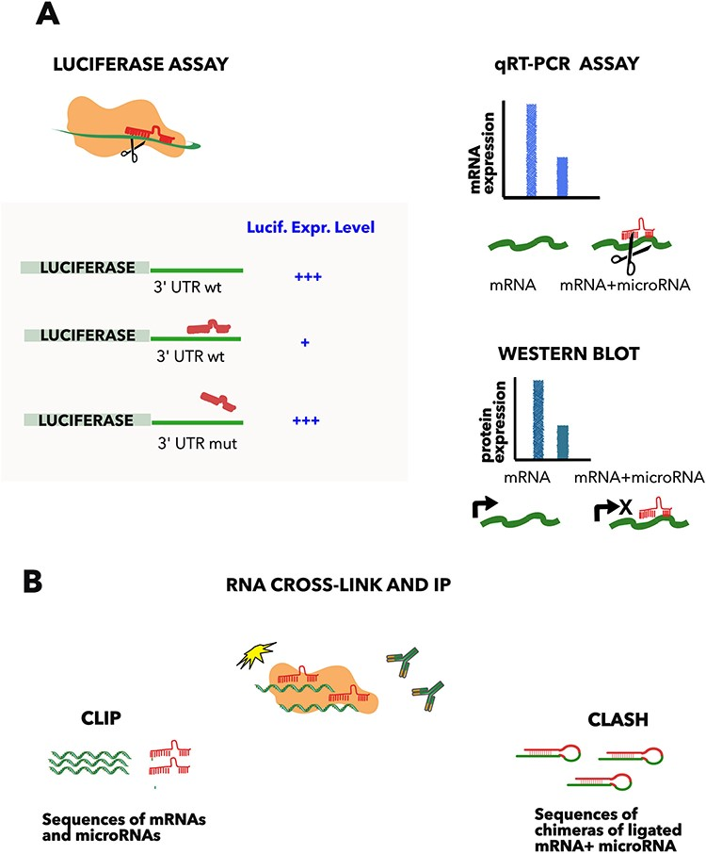
Figure 1. Methods commonly used to detect microRNA–mRNA interactions. (A) Luciferase assay comprises the fusion of the ...
Notes:
Figure 1. Methods commonly used to detect microRNA–mRNA interactions. (A) Luciferase assay comprises the fusion of the luciferase gene to the 3ʹ UTR of the microRNA target gene and the subsequent transfection of the construct with or without the microRNA. The approach demonstrates the direct interaction, compared to a mutated copy of the predicted complementary region, which acts as a negative control. Quantification of the mRNA (qRT-PCR) or protein level (western blot) helps to distinguish between the mRNA degradation and the translation inhibition, but is not proof of an interaction when used in isolation. (B) CLIP and CLASH. Cross-linking and immunoprecipitation of a RNA binding protein (such as AGO2), followed by RNA sequencing, allows the determination of all the RNAs bound to the protein. These approaches demonstrate direct RNA–RNA binding, if the two interacting RNAs are ligated in a hybrid before sequencing (CLASH (9)).
Unless provided in the caption above, the following copyright applies to the content of this slide: © The Author(s) 2023. Published by Oxford University Press.This is an Open Access article distributed under the terms of the Creative Commons Attribution License (https://creativecommons.org/licenses/by/4.0/), which permits unrestricted reuse, distribution, and reproduction in any medium, provided the original work is properly cited.

