Slide 1
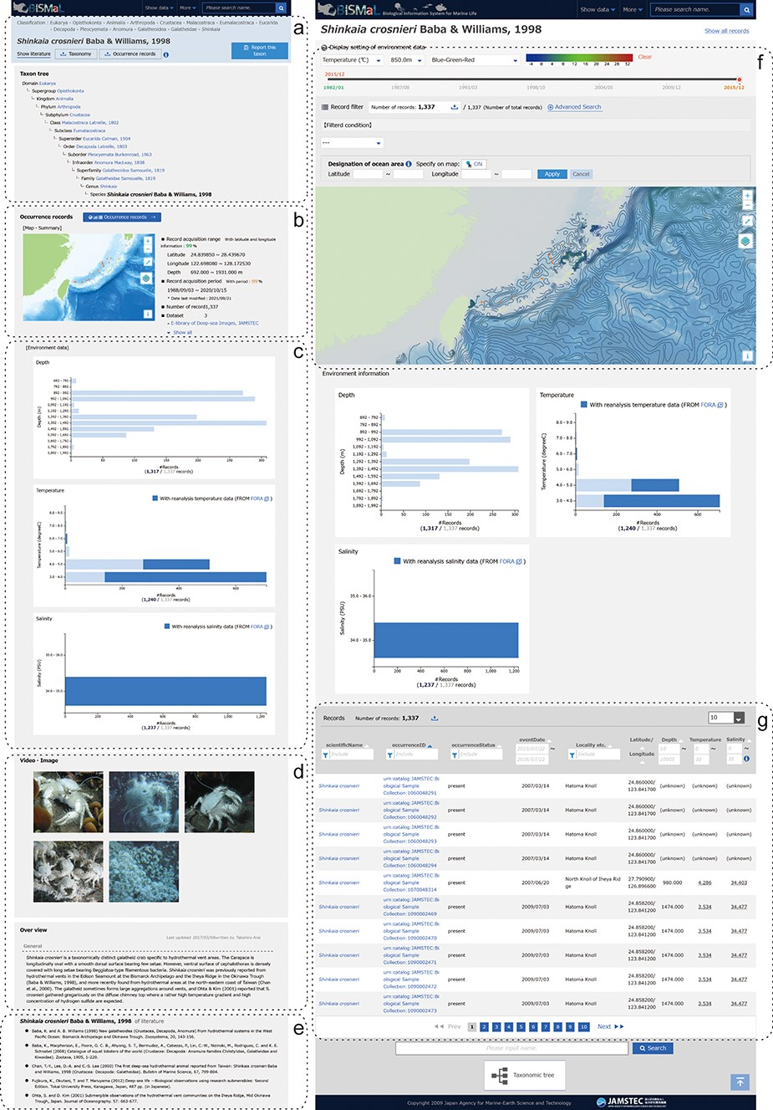
Figure 1. Screenshots of the BISMaL web page for S. crosnieri. Left panel: a taxonomic information page ...
Notes:
Figure 1. Screenshots of the BISMaL web page for S. crosnieri. Left panel: a taxonomic information page (https://www.godac.jamstec.go.jp/bismal/e/view/9000078) composed of taxonomic tree (a), map view of biological observation records (b), histograms of environmental conditions (c), related images and notes (d) and references (e). Right panel: a biological observation record page (https://www.godac.jamstec.go.jp/bismal/e/occurrences?taxon=9000078) composed of map view with estimated environmental contours (f) and observation records (g). Estimated salinity or temperature for observation records is shown as underlined values.
Unless provided in the caption above, the following copyright applies to the content of this slide: © The Author(s) 2023. Published by Oxford University Press.This is an Open Access article distributed under the terms of the Creative Commons Attribution License (https://creativecommons.org/licenses/by/4.0/), which permits unrestricted reuse, distribution, and reproduction in any medium, provided the original work is properly cited.

