Slide 1
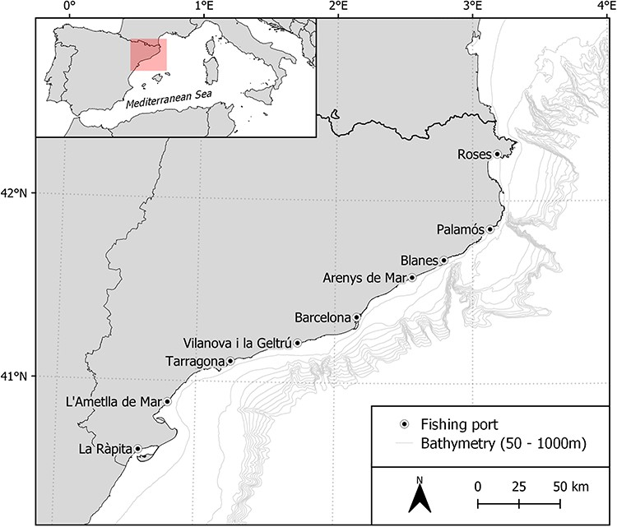
Figure 1. Map showing the study area along the Catalan coast (NW Mediterranean Sea), where the bottom trawling ...
Notes:
Figure 1. Map showing the study area along the Catalan coast (NW Mediterranean Sea), where the bottom trawling samplings take place). Sampling fishing ports are displayed on the map.
Unless provided in the caption above, the following copyright applies to the content of this slide: © The Author(s) 2023. Published by Oxford University Press.This is an Open Access article distributed under the terms of the Creative Commons Attribution License (https://creativecommons.org/licenses/by/4.0/), which permits unrestricted reuse, distribution, and reproduction in any medium, provided the original work is properly cited.

Slide 2
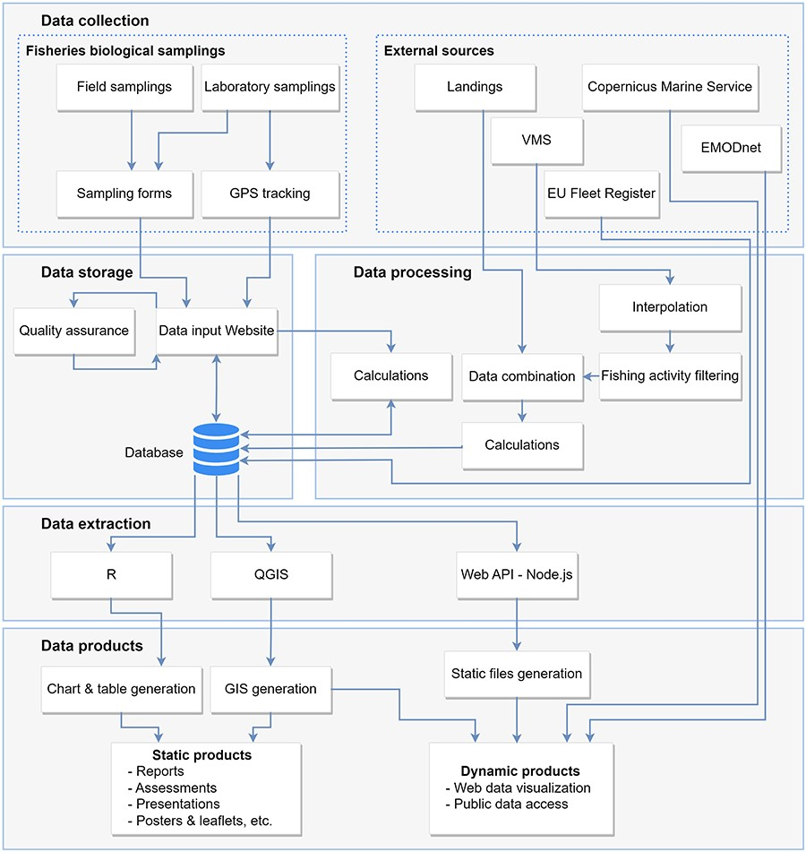
Figure 2. Diagram of the data workflow: data collection, processing, storage, extraction and products.
Notes:
Figure 2. Diagram of the data workflow: data collection, processing, storage, extraction and products.
Unless provided in the caption above, the following copyright applies to the content of this slide: © The Author(s) 2023. Published by Oxford University Press.This is an Open Access article distributed under the terms of the Creative Commons Attribution License (https://creativecommons.org/licenses/by/4.0/), which permits unrestricted reuse, distribution, and reproduction in any medium, provided the original work is properly cited.

Slide 3
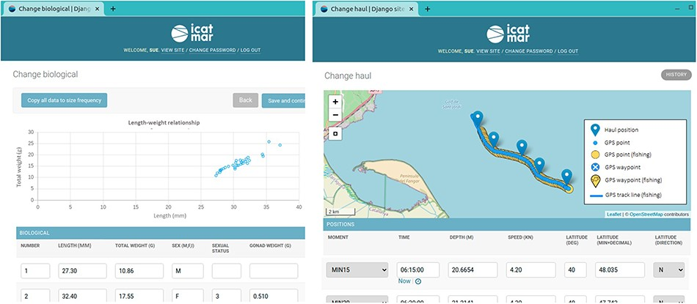
Figure 3. Examples of the data input website displaying interactive charts and maps to perform visual validations of ...
Notes:
Figure 3. Examples of the data input website displaying interactive charts and maps to perform visual validations of the entered data. The scatter chart displays the individuals’ lengths and weights to detect possible outliers. The interactive chart is displaying the onboard positions (blue pointers), together with the uploaded GPS points (blue circles) and the GPS points detected as fishing (yellow circles).
Unless provided in the caption above, the following copyright applies to the content of this slide: © The Author(s) 2023. Published by Oxford University Press.This is an Open Access article distributed under the terms of the Creative Commons Attribution License (https://creativecommons.org/licenses/by/4.0/), which permits unrestricted reuse, distribution, and reproduction in any medium, provided the original work is properly cited.

Slide 4
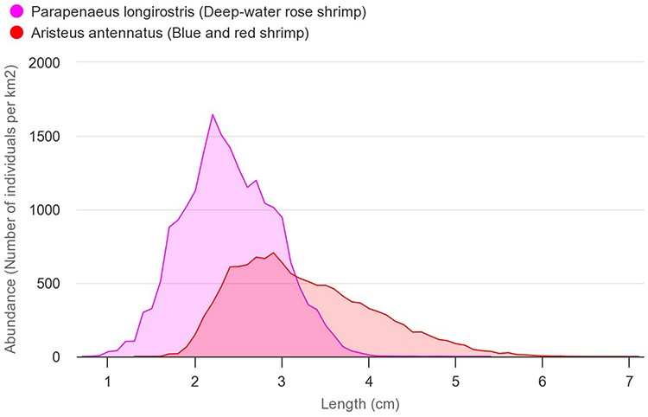
Figure 5. Comparison of the length-frequency distributions of blue and red shrimp (A. antennatus—red) and deep-water ...
Notes:
Figure 5. Comparison of the length-frequency distributions of blue and red shrimp (A. antennatus—red) and deep-water rose shrimp (P. longirostris—pink). The abundances on the chart are the average of all areas and years (number of individuals/km2).
Unless provided in the caption above, the following copyright applies to the content of this slide: © The Author(s) 2023. Published by Oxford University Press.This is an Open Access article distributed under the terms of the Creative Commons Attribution License (https://creativecommons.org/licenses/by/4.0/), which permits unrestricted reuse, distribution, and reproduction in any medium, provided the original work is properly cited.

Slide 5
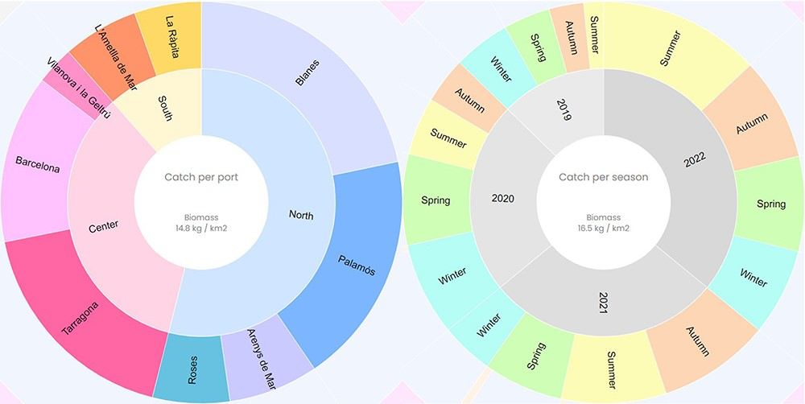
Figure 6. Catch composition per port and season of the deep-water rose shrimp (P. longirostris). The value of the ...
Notes:
Figure 6. Catch composition per port and season of the deep-water rose shrimp (P. longirostris). The value of the central circle is the average of the species’ biomass per port or season (kg/km2).
Unless provided in the caption above, the following copyright applies to the content of this slide: © The Author(s) 2023. Published by Oxford University Press.This is an Open Access article distributed under the terms of the Creative Commons Attribution License (https://creativecommons.org/licenses/by/4.0/), which permits unrestricted reuse, distribution, and reproduction in any medium, provided the original work is properly cited.

Slide 6
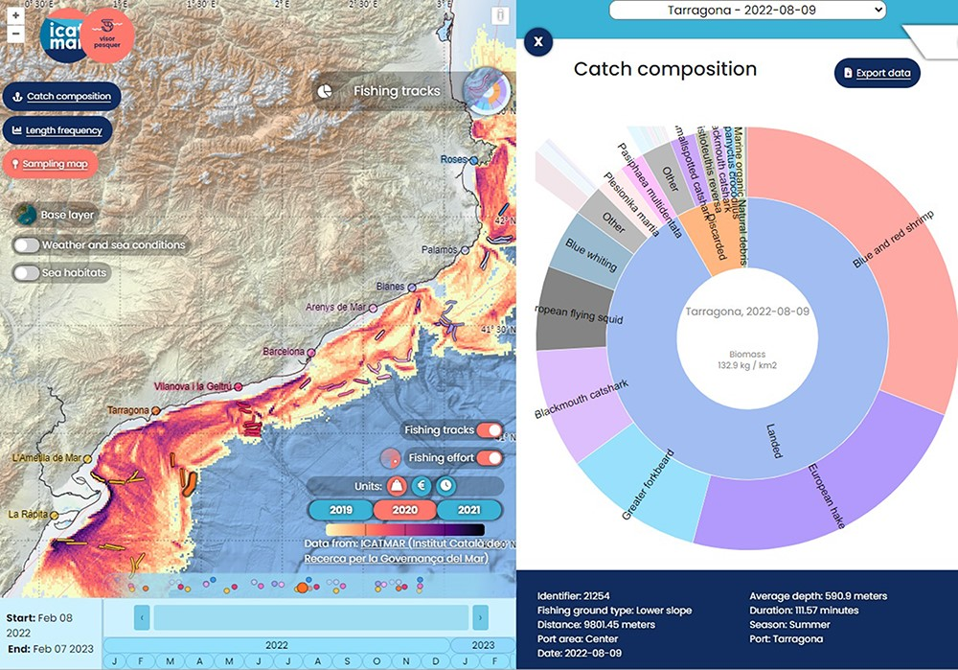
Figure 7. Catch geolocation of a bottom trawling sampling. An additional layer with the biomass extracted for all the ...
Notes:
Figure 7. Catch geolocation of a bottom trawling sampling. An additional layer with the biomass extracted for all the fishing fleet (kg/km2) is added to the map.
Unless provided in the caption above, the following copyright applies to the content of this slide: © The Author(s) 2023. Published by Oxford University Press.This is an Open Access article distributed under the terms of the Creative Commons Attribution License (https://creativecommons.org/licenses/by/4.0/), which permits unrestricted reuse, distribution, and reproduction in any medium, provided the original work is properly cited.

Slide 7
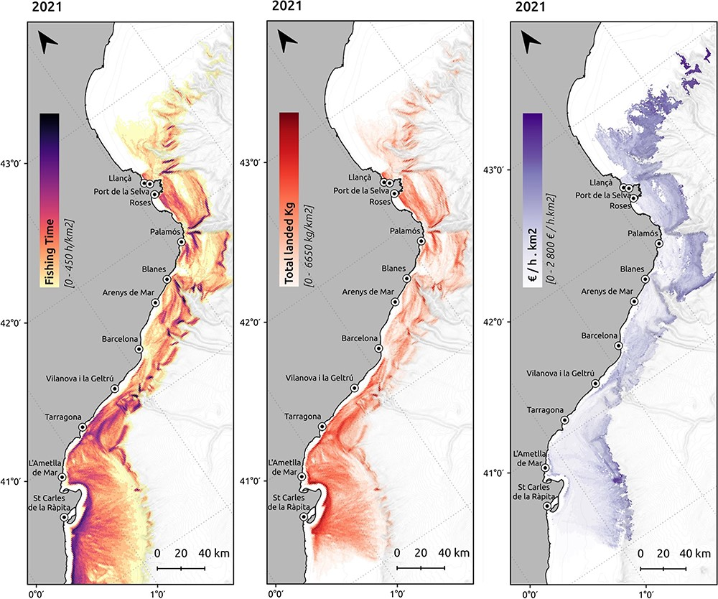
Figure 4. Spatial distribution of the fishing effort (h/km²), landings (km/km²) and revenues per ...
Notes:
Figure 4. Spatial distribution of the fishing effort (h/km2), landings (km/km2) and revenues per unit of effort (€/h· km2) produced by the bottom trawling fishing fleet in 2021.
Unless provided in the caption above, the following copyright applies to the content of this slide: © The Author(s) 2023. Published by Oxford University Press.This is an Open Access article distributed under the terms of the Creative Commons Attribution License (https://creativecommons.org/licenses/by/4.0/), which permits unrestricted reuse, distribution, and reproduction in any medium, provided the original work is properly cited.

Slide 8
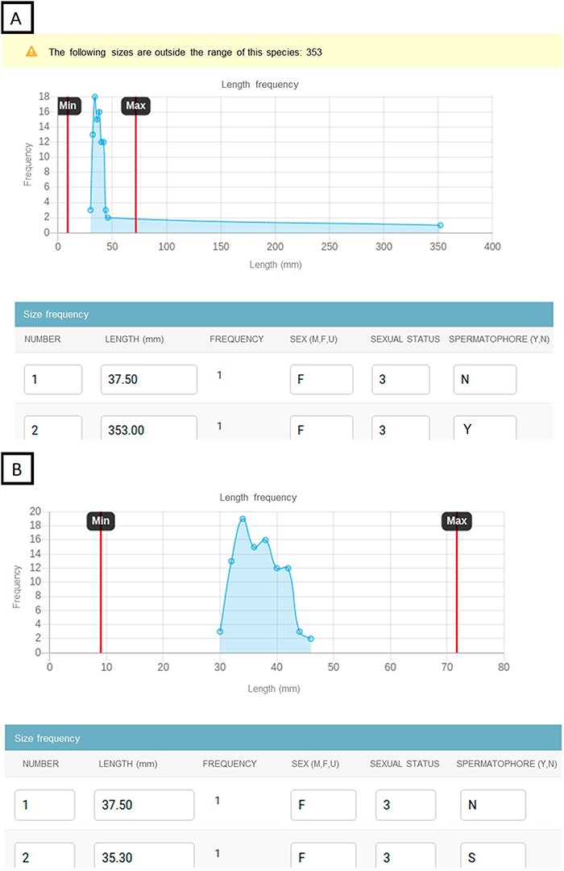
Figure 8. Example of the data input website to prevent incorrect data. The website displays a line chart with the ...
Notes:
Figure 8. Example of the data input website to prevent incorrect data. The website displays a line chart with the length frequency and species’ length ranges. If some lengths are out of the range, they can be detected in the length frequency chart and the website triggers a warning with the lengths that need to be checked. Chart showing the lengths out of range with a warning detecting the outliers (A). Chart showing the fixed lengths that fall within the range values (B).
Unless provided in the caption above, the following copyright applies to the content of this slide: © The Author(s) 2023. Published by Oxford University Press.This is an Open Access article distributed under the terms of the Creative Commons Attribution License (https://creativecommons.org/licenses/by/4.0/), which permits unrestricted reuse, distribution, and reproduction in any medium, provided the original work is properly cited.

