Slide 1
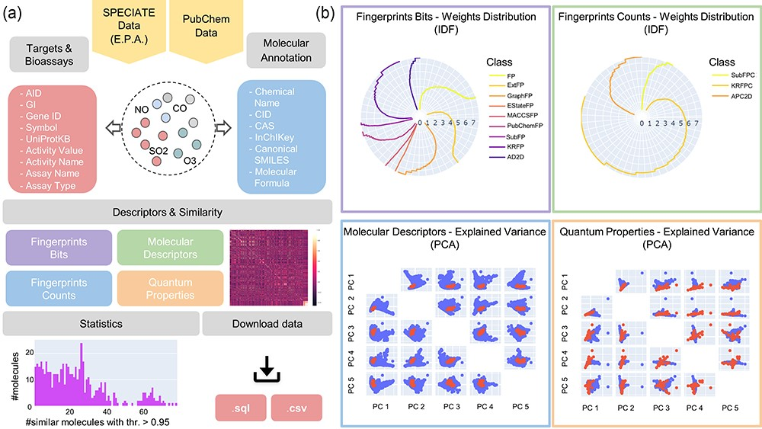
Figure 1. An APDB overview. (a) The online resources, the collected molecular annotations, targets and bioassays, the ...
Notes:
Figure 1. An APDB overview. (a) The online resources, the collected molecular annotations, targets and bioassays, the computed molecular descriptors and similarities, the data statistics and the download functionalities. (b) The IDF weights distribution of fingerprints bits and counts and the first five principal components of molecular descriptors and quantum properties.
Unless provided in the caption above, the following copyright applies to the content of this slide: © The Author(s) 2023. Published by Oxford University Press.This is an Open Access article distributed under the terms of the Creative Commons Attribution License (https://creativecommons.org/licenses/by/4.0/), which permits unrestricted reuse, distribution, and reproduction in any medium, provided the original work is properly cited.

