Slide 1
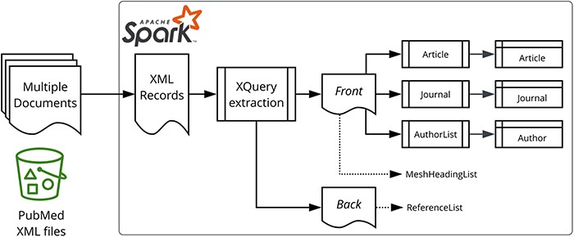
Figure 1. Data processing overview. Apache Spark and the star logo are trademarks of the Apache Software Foundation in ...
Notes:
Figure 1. Data processing overview. Apache Spark and the star logo are trademarks of the Apache Software Foundation in the United States and/or other countries.
Unless provided in the caption above, the following copyright applies to the content of this slide: © The Author(s) 2023. Published by Oxford University Press.This is an Open Access article distributed under the terms of the Creative Commons Attribution License (https://creativecommons.org/licenses/by/4.0/), which permits unrestricted reuse, distribution, and reproduction in any medium, provided the original work is properly cited.

Slide 2
Figure 2. JSON representation within XQuery.
Notes:
Figure 2. JSON representation within XQuery.
Unless provided in the caption above, the following copyright applies to the content of this slide: © The Author(s) 2023. Published by Oxford University Press.This is an Open Access article distributed under the terms of the Creative Commons Attribution License (https://creativecommons.org/licenses/by/4.0/), which permits unrestricted reuse, distribution, and reproduction in any medium, provided the original work is properly cited.

Slide 3
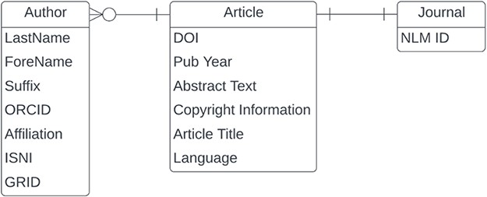
Figure 3. Entity relationship diagram for a subset of PubMed.
Notes:
Figure 3. Entity relationship diagram for a subset of PubMed.
Unless provided in the caption above, the following copyright applies to the content of this slide: © The Author(s) 2023. Published by Oxford University Press.This is an Open Access article distributed under the terms of the Creative Commons Attribution License (https://creativecommons.org/licenses/by/4.0/), which permits unrestricted reuse, distribution, and reproduction in any medium, provided the original work is properly cited.

Slide 4
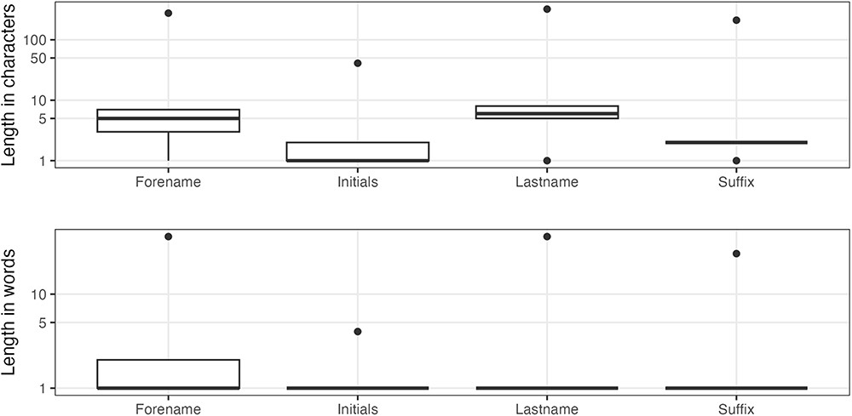
Figure 4. Author name character/word distributions.
Notes:
Figure 4. Author name character/word distributions.
Unless provided in the caption above, the following copyright applies to the content of this slide: © The Author(s) 2023. Published by Oxford University Press.This is an Open Access article distributed under the terms of the Creative Commons Attribution License (https://creativecommons.org/licenses/by/4.0/), which permits unrestricted reuse, distribution, and reproduction in any medium, provided the original work is properly cited.

Slide 5
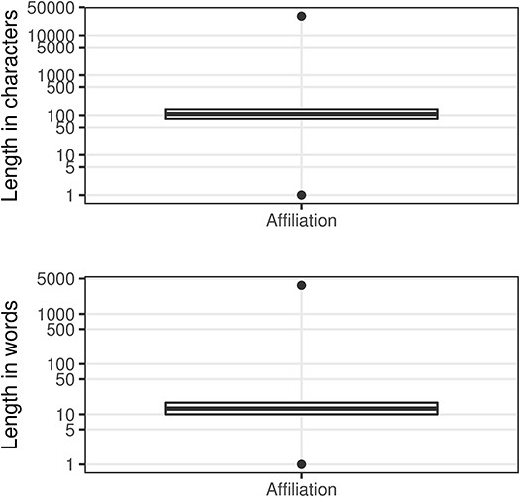
Figure 5. Affiliation character/word distributions.
Notes:
Figure 5. Affiliation character/word distributions.
Unless provided in the caption above, the following copyright applies to the content of this slide: © The Author(s) 2023. Published by Oxford University Press.This is an Open Access article distributed under the terms of the Creative Commons Attribution License (https://creativecommons.org/licenses/by/4.0/), which permits unrestricted reuse, distribution, and reproduction in any medium, provided the original work is properly cited.

Slide 6
Figure 6. An example of narrative affiliations.
Notes:
Figure 6. An example of narrative affiliations.
Unless provided in the caption above, the following copyright applies to the content of this slide: © The Author(s) 2023. Published by Oxford University Press.This is an Open Access article distributed under the terms of the Creative Commons Attribution License (https://creativecommons.org/licenses/by/4.0/), which permits unrestricted reuse, distribution, and reproduction in any medium, provided the original work is properly cited.

Slide 7
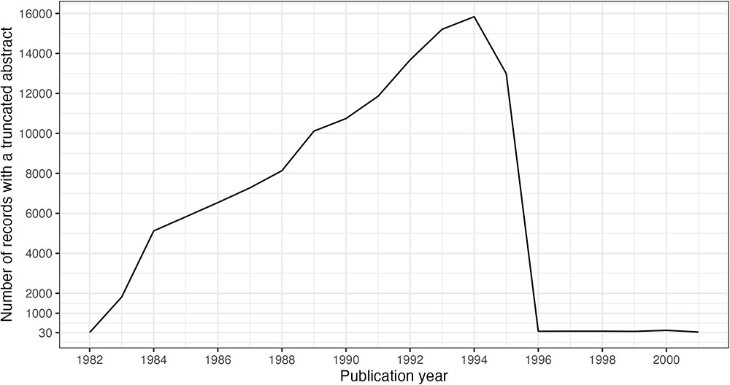
Figure 9. Truncated abstracts by publication year. Filtered to include years with ≥30 occurrences.
Notes:
Figure 9. Truncated abstracts by publication year. Filtered to include years with ≥30 occurrences.
Unless provided in the caption above, the following copyright applies to the content of this slide: © The Author(s) 2023. Published by Oxford University Press.This is an Open Access article distributed under the terms of the Creative Commons Attribution License (https://creativecommons.org/licenses/by/4.0/), which permits unrestricted reuse, distribution, and reproduction in any medium, provided the original work is properly cited.

Slide 8
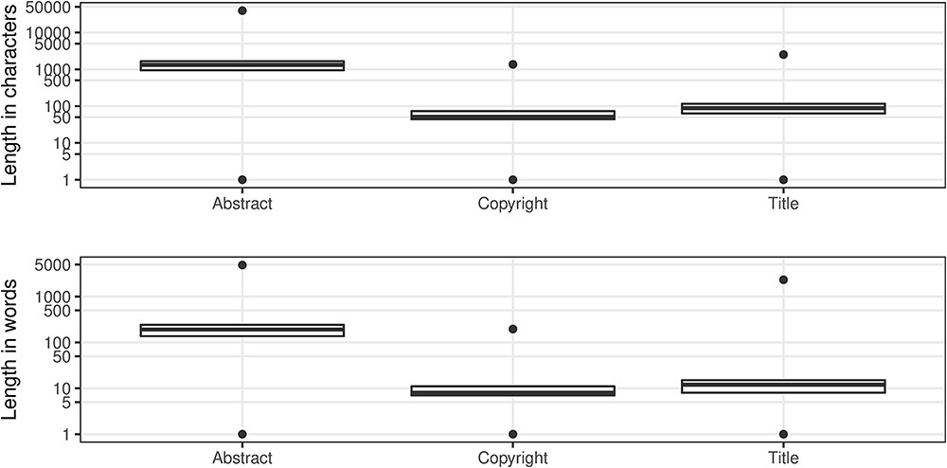
Figure 8. Article character/word distributions.
Notes:
Figure 8. Article character/word distributions.
Unless provided in the caption above, the following copyright applies to the content of this slide: © The Author(s) 2023. Published by Oxford University Press.This is an Open Access article distributed under the terms of the Creative Commons Attribution License (https://creativecommons.org/licenses/by/4.0/), which permits unrestricted reuse, distribution, and reproduction in any medium, provided the original work is properly cited.

Slide 9
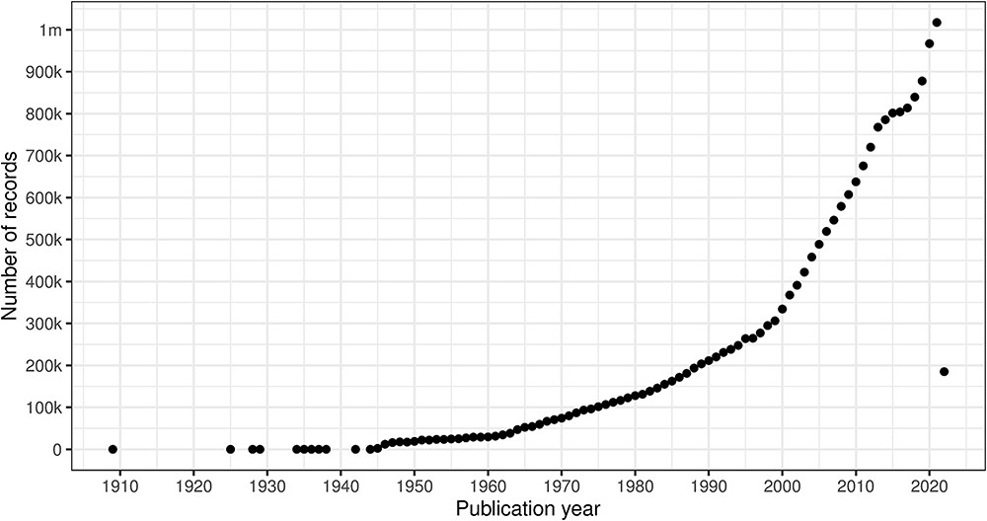
Figure 7. Count of citation records with a valid DOI per publication year (excluding erroneous years).
Notes:
Figure 7. Count of citation records with a valid DOI per publication year (excluding erroneous years).
Unless provided in the caption above, the following copyright applies to the content of this slide: © The Author(s) 2023. Published by Oxford University Press.This is an Open Access article distributed under the terms of the Creative Commons Attribution License (https://creativecommons.org/licenses/by/4.0/), which permits unrestricted reuse, distribution, and reproduction in any medium, provided the original work is properly cited.

Slide 10
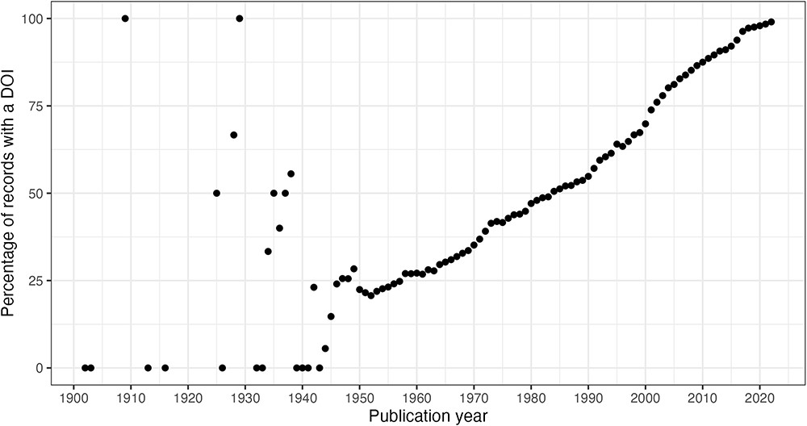
Figure 10. DOI percentage of articles per publication year.
Notes:
Figure 10. DOI percentage of articles per publication year.
Unless provided in the caption above, the following copyright applies to the content of this slide: © The Author(s) 2023. Published by Oxford University Press.This is an Open Access article distributed under the terms of the Creative Commons Attribution License (https://creativecommons.org/licenses/by/4.0/), which permits unrestricted reuse, distribution, and reproduction in any medium, provided the original work is properly cited.

Slide 11
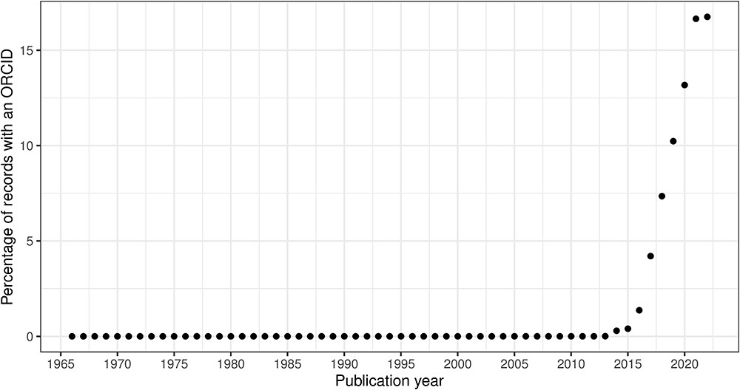
Figure 11. ORCID percentage of authors per publication year.
Notes:
Figure 11. ORCID percentage of authors per publication year.
Unless provided in the caption above, the following copyright applies to the content of this slide: © The Author(s) 2023. Published by Oxford University Press.This is an Open Access article distributed under the terms of the Creative Commons Attribution License (https://creativecommons.org/licenses/by/4.0/), which permits unrestricted reuse, distribution, and reproduction in any medium, provided the original work is properly cited.

Slide 12
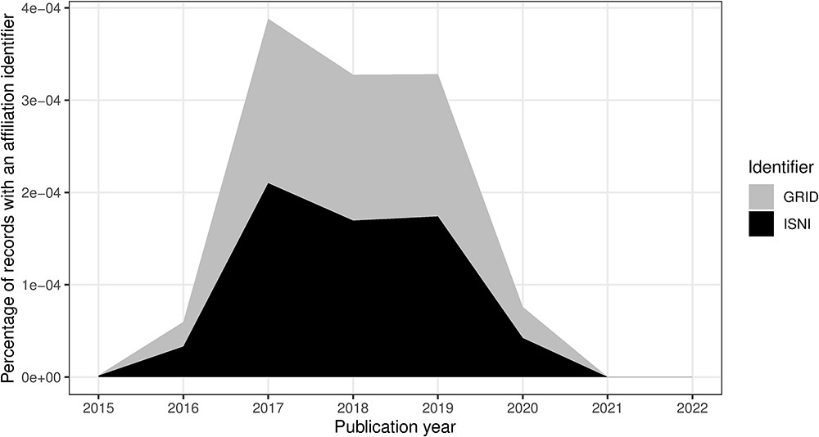
Figure 12. ISNI and GRID percentage of authors per publication year.
Notes:
Figure 12. ISNI and GRID percentage of authors per publication year.
Unless provided in the caption above, the following copyright applies to the content of this slide: © The Author(s) 2023. Published by Oxford University Press.This is an Open Access article distributed under the terms of the Creative Commons Attribution License (https://creativecommons.org/licenses/by/4.0/), which permits unrestricted reuse, distribution, and reproduction in any medium, provided the original work is properly cited.

Slide 13
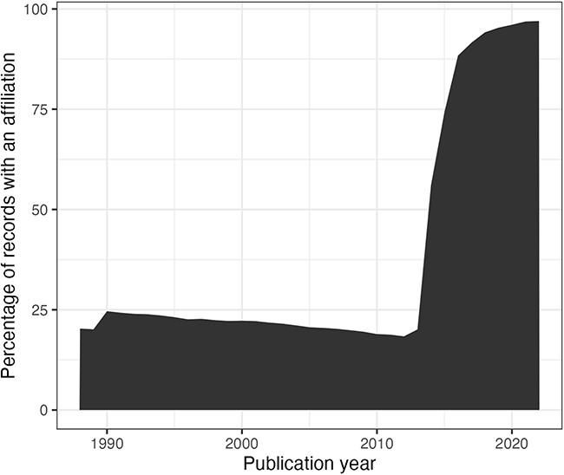
Figure 13. Percentage of authors per publication year (from 1988) with an affiliation string.
Notes:
Figure 13. Percentage of authors per publication year (from 1988) with an affiliation string.
Unless provided in the caption above, the following copyright applies to the content of this slide: © The Author(s) 2023. Published by Oxford University Press.This is an Open Access article distributed under the terms of the Creative Commons Attribution License (https://creativecommons.org/licenses/by/4.0/), which permits unrestricted reuse, distribution, and reproduction in any medium, provided the original work is properly cited.

